Slide 1
Reflecting on Developing a Creative Thinking Course for Community College Students
Noreen McGinness Olson CCT Synthesis, Spring 2013

Slide 2
My Schema
Context (10 min)
Theoretical Frameworks (10 min)
Reflections on Development (10 min)
Major Assignments (10 min)
Questions & Answers (5 min)
Notes:
In this presentation I will present my schema or pattern of thought that I have developed and I want to bring you through for the next 45 minutes

Slide 3
My Perspective
Who am I and What Perspectives do I Bring?
Former Art Student (B.A. from UMB)
Former Professional Videographer
Former Media Specialist and Instructional Designer
Adult CCT Graduate Student
Acting Community College Tutoring Director
Mother of three children
Notes:
I do not currently work as a professional artist, but my undergraduate major was art. For a few years I worked for a studio as a videographer for a local studio and also was hired as a media Specialist at Middlesex Community College which I still am currently employed.
I was hired to set up audio/visual equipment for events at MCC and occasionally worked on an instructional or promotional video for different departments across the college.
However, the videos that were produced were few and far between at the college soon after I was hired they put a computer on my desk. I did not grow up with computers, but I did take to learning new software pretty easily and with a lot of down time between setting up events and classrooms on my own I began to learn how to use different software. I also became connected with some of the people who were starting to develop an online learning program at the school. Through many conversations and professional development opportunities, I began to develop an interest in teaching and learning with a special interest in instructional technologies. It was through encouragement from colleagues that I began a Masters program in instructional technologies.
I only took two courses in that program and did not love them. I did not feel passionate about instructional technologies. Eventually came across the CCT program through talking to several colleagues at work who were enrolled. I took a course and was hooked. The thought about learning how to approach complex problems in many areas of interest was intriguing. And I believe it was this program that helped me and others believe in my capabilities as a critical and creative thinker that I was asked to lead a new direction for the Academic Support & Tutoring department last semester.
In addition to my academic and professional experience, I am a mother of three children who show me daily how different people are even given similar upbringings and genetic make-up, they have bring their own strengths and perspectives to the table.

Slide 4
Learn More about the Creative Process by Developing a Creative Thinking Course
Continued Research on Creativiy
Develop My Own Creativity
Review other Creative Thinking Courses
Synthesize What I Have Learned in CCT
Learn More about the Creative Process by Developing a Creative Thinking Course
Continued Research on Creativity
Develop My Own Creativity
Review other Creative Thinking Courses
Synthesize What I Have Learned in CCT
Reflect and Take Stock
Develop Course
Reflect on Choices
Notes:
This graphic represents the on-going process I engaged in this semester and previous to the semester. In order to Learn more about the creative process while developing a creative thinking course I engaged in continued research on creativity. I attempted to participated in the Artist’s Way to re-discover my creative process as an artist. I also reviewed other syllabi and incorporated what I had learned about Critical and Creative Thinking in CCT into the process.
This process was cyclical in nature I feel I took stock while developing the course and am now reflecting on the choices that I have made.

Slide 5
Discovering My Own Creativity and Creating a Path for Others
In college took I many liberal arts courses, but not really engaged and did not see connections
Happened across a film class and…
Did well
Took additional courses (art and art history)
Changed my major to Art
Challenged my notion of myself as a non-creative person!
Notes:
I have never thought of myself as creative. When I attended college I did not know what subject to study and began taking different types of elective courses that I found interesting based on their descriptions in order to pick a major. I took some law courses and while I enjoyed the logical thinking, I was not completely engaged in the subject matter. I also took psychology and sociology courses which I enjoyed as well, but when I thought about it, I could not imagine myself in any professions I knew of linked to those fields.
Then I took a film course. I had always loved good films and even thought it would be fun and creatively fulfilling to make my own film. I fell in love with the course immediately, however, I did not even think about this course as one that would lead to selecting a major. That would be silly since I knew that I was not creative; everyone knew my youngest brother Richie was the creative one in the family. After all, Richie wrote poetry, made art, and generally expressed the sensitive nature of an artist that my mother treasured. To my disbelief, I received an A in the film class and, based on my success, decided to take more film and photography classes. I soon discovered I was not only interested in film analysis and production, but also in photography and art history as well. Eventually, I managed to accumulate the courage to change my major and earned a bachelor degree in Art, surprising everyone including myself! Taking that first film course changed my life and how I viewed myself and my own creativity.
Many people do not see themselves as creative because they have been told they are not and believe it. Also, there are two societal misconceptions that interfere with individuals accepting their own creative natures - first, creativity only lives in the fine arts and, second, that people cannot learn to be creative; they are or they aren’t. I feel I am improving my creativity all the time; however, I have not been cognizant of it until recently. I believe becoming conscious of your own creativity and creative process is a required component to flourish as an artist, thinker, business person, inventor, innovator, or whatever profession you choose and this is what I would like the students who take my course discover – rather than become experts in creativity theories and practice I want them to discover what they are passionate about and to cognizant of their creative process.
This is how my personal experiences helped me to set an overarching goal for the creative thinking course.

Slide 6
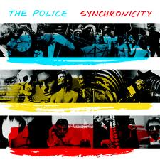
Synchronicity!
College launching new Entrepreneurial Business Certificate program
Looking for someone to develop interdisciplinary Creative Thinking class out of Humanities and Social Sciences Division
I was selected due to my background and participation in CCT program
Course Pilot Proposal passed Curriculum Committee Spring 2013, to be offered Fall 2013
Notes:
In spring of 2012, the implementation of a new Entrepreneurship in Small Business Management certificate program at Middlesex Community College triggered the need for a creative thinking course and a mini-grant was written for course development. This course will be a requirement of the program, based on the idea that creativity is a necessary aspect of entrepreneurship. In the fall 2012, I was approached by the Dean of Business, Education and Public Service for my ideas regarding the creative thinking course and was delighted to be asked to develop and teach this new course myself.
Although requested by the Business Division, this course was not intended to be taught as a business course. Rather, the course is to be an interdisciplinary experience offered through the Humanities and Social Science Division addressing the psychological and human dimensions of creativity. I have worked closely with the Assistant Dean of Social Sciences and the Chair of the Behavioral Sciences Department to determine the appropriate scope of the course. Together, we presented the course to the Middlesex Curriculum Committee in February of 2013 at which time the pilot was approved.

Slide 7
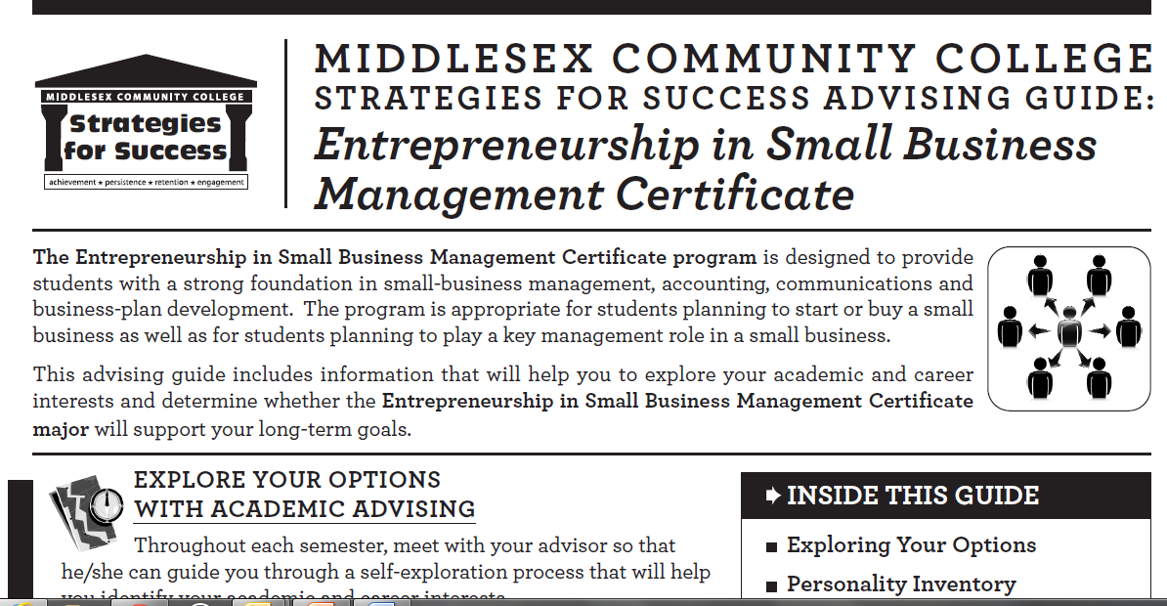
Notes:
This is the information the college has put together regarding the new certificate program.

Slide 8
Course Description
This interdisciplinary course will increase students’ understanding of the nature of creativity and creative problem solving. It provides students with an introduction to skills and techniques designed to increase their creativity and ability to develop innovative solutions to meaningful problems. Students will analyze the creative process from a variety of theoretical perspectives and participate in activities that develop capacities to generate original ideas. Topics include modern theories of creativity from psychology and allied fields, environments that enhance creative functioning, techniques to promote divergent thinking, and case studies of creative individuals. A variety of critical and creative thinking skills designed to boost creativity will be explored and practiced. Knowledge and skills gained in this course are applicable to solving business, scientific, and environmental problems, as well as the arts and sciences and other areas of personal interest.
Notes:
I spent a lot of time working with the Chair of the Behavioural science department and the Assistant dean of the business department refining the course description and I won’t read it all to you, but I wanted to highlight the main goal of mine at the end that “Knowledge and skills gained in this course are applicable to solving business, scientific and environmental problems as well as the arts and sciences and other areas of personal interest.” This is important to me because I want the students to discover what is important to them and to realize they can be creative in this field.

Slide 9
Multiple Intelligences (Gardner)
Triarchic Theory of Intelligence (Sternberg)
Eastern Perspectives of Creativity (Chang)
6 P’s of Creativity
Everyday Creativity – Big “C” or Little “c”
Frames of Reference
Social Conditions
Positive Psychology (Seligman)
Growth Mindset (Dweck)
Thinking Fast and Thinking Slow (Systems 1 and 2) (Kahneman)
Theoretical Frameworks
Notes:
These are the theoretical frameworks that have been influential in my thinking.

Slide 10
Intelligence and Creativity
Howard Gardner (Harvard) Multiple Intelligences
Creativity is a subset of each Intelligence
His research focuses on “Big C” creativity
Robert Sternberg – Confluence approach to creativity
Creativity emerges from “the convergence of basic resources (such as)
intellectual abilities
knowledge base
flexibility in thinking
personality traits
supportive environments.
Notes:
Howard Gardner’s work on Multiple Intelligences has had a profound impact on education. The notion that it is not how smart you are, but rather how you are smart has many implications for the way society should educate people. According to Gardner, people possess different kinds of minds and learn and recall information in different ways. Gardner (reference) identified nine different intelligences: ranging from logical-mathmatical,visual-spacial to bodily-kinesthetic, In addition, he believes creativity is a subset of each type of intelligence, and, while an individual may be creative within one or two disciplines or domains, no one can achieve creativity across all intelligences. Gardner’s research focuses on “Big C” creativity, the kind of creativity that creates changes within their specific domains. While he does not deny that creativity exists in the small and medium “c” capacities, he feels strongly that in order to understand the concept of creativity you must look at people who have made large contributions to their domains (Gardner, 1999, p. 117).
By contrast, psychologist Robert Sternberg does believe that creativity can be developed within the individual. In his confluence approach to creativity and the investment theory, novel ideas and creativity emerge from the convergence of basic resources and these five resources can be developed and learned in order to improve one’s creativity.
For example: (1) intellectual abilities refer to the ability to see problems in new ways and with the ability to persuade others that your ideas are worthwhile. There are known strategies for developing and exercising the ways people see themselves in a variety of contexts. In addition, by engaging in conversation around your ideas you will naturally improve communication skills and persuasion techniques;
(2) I believe finding your passion is important for building your knowledge base. Having passion for a topic or profession will provide the intrinsic motivation necessary to build a rich knowledge base in your domain;
(3) flexibility in thinking styles – it is common for people who view themselves as creative to get into a creative rut or become blocked and there are different strategies to help people unblock or build new ways of thinking; (4) Personality traits – I have observed, within myself and others, a difference in behavior when around certain people. Behavioral traits, such as willingness to take risks and tolerating ambiguity, are known to be traits of creative people. These traits can be learned with modeling and practice; I think surrounding yourself with people who are positive and willing to take risks, make mistakes and try again is central to developing these traits; and
(5) a supportive environment in which change is encouraged and uniformity of thought is not imposed. I think this may be the hardest factor to change of the five for socio economic and cultural reasons.
These theories have informed the way I think about the development of the course. To promote the creativity that exists in all individuals, to reflect on big C creative people, to understand one’s own creative process and take steps to unblock creativity.

Slide 11
Eastern View of Creativity
Creativity is not a form of intelligence
It is a natural part of the universe
Can be achieved by individuals who reach a certain state of mind
Ming (insight) vs. Ching (connection and awareness)’
Yin-yang describes duality of universe
Influences course to promote quiet reflection and following one’s passion
Notes:
I also wanted to draw from both western and eastern views of creativity since they are so different, but in some ways two sides of the same coin.
This Creative Thinking course will draw from the Taoist notion of ching to promote reflection, and tranquil contemplation in order for new ideas to incubate and emerge. In contrast to the Western view that sees creativity as a form of intelligence, the Eastern view sees creativity as a natural aspect of the nature of the universe that may be accessed by individuals who achieve a particular frame of mind.
The Eastern view of creativity is informed by a variety of philosophies including Confucianism, Buddhism and Taoism. For the purposes of this project I focused my research on the influence of Taoist thought in the Eastern view of creativity. Taoism places significant focus on the process of self-realization and its influence on creativity. I chose to focus in this way because I believe these ideas complement and augment ideas that come from Positive Psychology, another major influence on the course.
According to Taoism there are two means of achieving enlightenment, ming and ching. (Chang, 2011, 274) Ming is described as developing insight into the nature of the universe and acting harmoniously with the natural world. On the other hand, ching or quiescence deals with the process of self-realization or a state of personal fulfillment. Quiescence is a state of inactivity or dormancy we achieve through meditation referred to as ching. According to the Taoists, through meditation and the use of breathing exercises we can develop a sense of spiritual wisdom and connectedness to our inner self. Through an awareness of ourself and our environment, we can free ourselves from the confusion or chaos in the world by obtaining inner peace.
One of the fundamental principles of Taoism is yin-yang which is symbolized by the familiar half-black and half-white circle with a white dot on the black side and a black dot on the white side (Figure 1.1). This symbol represents the idea that all things exist in duality and that everything contains its opposite. From the Taoist perspective nature is a set of contrarily opposed forces that create duality and interrelations in all things.
Figure 1.1 yin-yang symbol
The yin-yang concept is illustrated by the state of ching in which all things are connected in a never-ending process of construction, deconstruction and construction again, allowing for new connections and perspectives to develop.
The idea that insights and new perspectives can be born from a tranquil state is not unique to Eastern thought. The Western idea of incubation has been proposed as an important aspect of creative thinking. Through incubation you sit with your ideas, taking a break from conscious processing and allowing your unconscious mind to work on the problem. This rest period often results in unique combinations of ideas. This course will try to promote quite reflection and interspection and self-awareness as part of understanding their creative process.

Slide 12
6 P’s of Creativity
Creative Process
Creative Product
Creative Personality
Creative Place
Creative Persuasion
Creative Performances (or Potential)
Notes:
The six P’s framework for the study of creativity (reference) is helpful in thinking about the nature of creativity and has influences how I will structure the activities in the Creative Thinking Course. For example activities based in the developmental creativity theory, would have process, person place, but not product.
The six p’s will be used as a broad frame work to locate any individual theory or concept within this structure.
The six p’s will provide structure for students as they look at the different ways creativity is understood and developed.

Slide 13
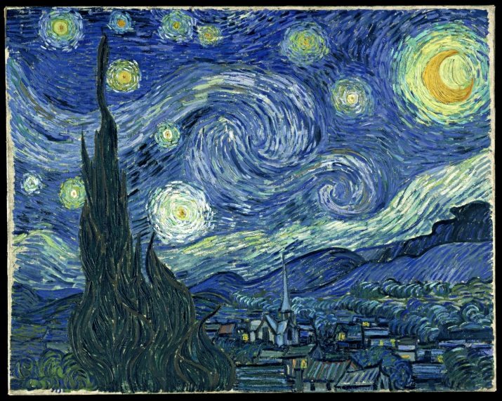
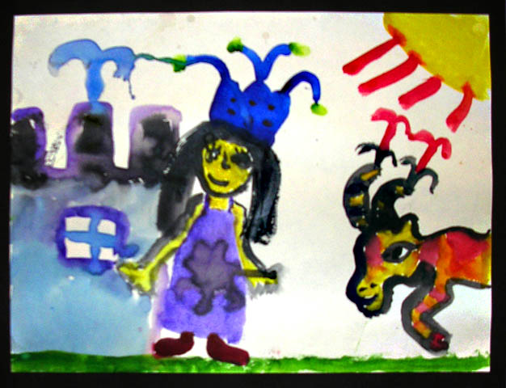
Everyday Creativity – Big C or Little c?
Big “C” creative people are important but this course is based in idea that all people can be “little c” creative
Notes:
In order to study creativity a category of creative magnitude was developed (which I referenced earlier when I talked about Gardner’s Multiple intelligence theory) in order to study the scope and focus of different creativity theories. Big “C” refers creativity and major contributions to a domain and Little c refers to creativity in everyday life.
As mentioned earlier Gardner’s research focuses on “Big C” creativity, the kind of creativity that creates changes within their specific domains. While he does not deny that creativity exists in the small and medium “c” capacities, he feels strongly that in order to understand the concept of creativity you must look at people who have made large contributions to their domains (Gardner, 1999, p. 117).
I agree and therefore think it’s important for students in my course to understand the nature of creativity they should study (as I did CCT602) big “C” creative people

Slide 14
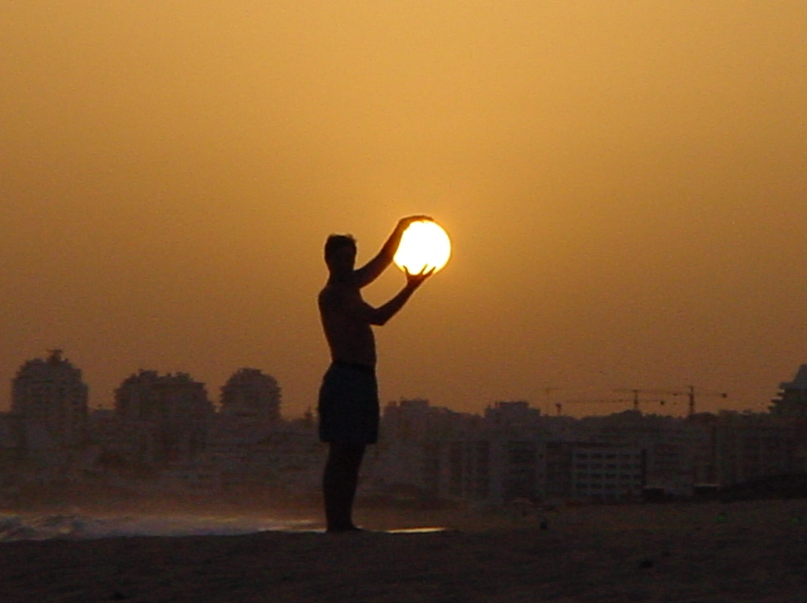
The Importance of Frames of Reference
Need to see problems from different perspectives
Exploring new frames of reference is a kind of creativity (Nickerson)
Avoid “functional fixedness”
Notes:
In addition to having the ability to discover novel ideas that are applicable or useful, creative thinkers also make connections by seeing problems from different perspectives. Nickerson suggests that creativity is a property of thinking. Many people refer to creative people as having a special talent to be expressed but may not think of themselves of having a special talent.
However, Nickerson suggests that originality can mean not just generating new ideas, but those that are new to the individual who has thought of them. Therefore, looking at a problem from different perspectives and exploring new frames of reference is a kind of creativity in everyday life. For example, imagining a story from a different perspective than the one it is written from; thinking of better ways to use your time; or seeing events or objects in a different light (avoiding functional fixedness) are all ways to practice individual creativity.
Students will be encouraged to look at problems through different perspectives and multiple frames of reference For example, pracetice using DeBono’s six thinking hats.

Slide 15
The Importance of Social Conditions
Ken Robinson
“driven more by collaboration than solo efforts”
Creativity cannot exist in a vacuum.
“creativity is a dialog between ideas and a particular medium”
Others in a domain must recognize creative idea as having value
Environment must be tolerant of mistakes
Society must provide opportunities for creativity
Notes:
Educator Ken Robinson has said, “Creativity is about making connections and is usually driven more by collaboration than solo efforts,” (Robinson, 2011 p 211). This statement emphasizes the importance of social context to creative thinking. One reason this idea resonates with me is that I do not believe that creativity can truly exist in a vacuum, based on the definition I am using for creativity as being novel and applicable to a given situation. As Robinson points out, creativity is a dialog between ideas and a particular medium (Robinson, 2011 p 153). Therefore, creative solutions must be seen by others in a domain and evaluated as both unique and useful to meet the definition. Further, making mistakes is an important part of the creative process. This is another situation in which having an interactive social environment in which to be creative is necessary. An environment that is tolerant of mistakes is one that promotes creative thought.
Creative thinking yields something novel and applicable, but is tied to self-actualization? Even if people are supported at home and are doing well in school, if the larger society does not provide them opportunities to be creative, then it is difficult to aspire to creativity. I can see how people who do not have opportunities for creativity can easily spend their life trying to fit in to a predetermined mold and therefore lose their self-confidence and ability to think creatively. As Ken Robinson asserts, we are all born as creative individuals and are educated out of our creativity through our socialization (reference). In fact, as I described in the introduction, if I had not happened across an undergraduate film course, this might well have happened to me.

Slide 16
The Relationship between Critical and Creative Thinking
Both are needed for problem solving
To think outside the box, you must carefully consider the box
Problem Solving Process: Recognizing the problem; possible solutions; identify assumptions and bias; looking from different perspectives; evaluating alternatives; reflecting on process
Notes:
What we might consider good thinking includes both critical and creative thinking. And, skills involved in critical thinking intertwine with creative thinking. To think outside the box one would need to take a good look at the box first and try to identify misconceptions, frames of references and assumptions that may be getting in the way of a new approach to whatever problem is being looked at.

Slide 17
Pioneered by Martin Seligman previously famous for “learned helplessness” and Mihaly Csikszentmihalyi
“…the purpose of positive psychology is to find and nurture the genius and talent that exist within individuals and increase satisfaction and fulfillment in everyday life.” (Compton, 2005)
陽性
Positive Psychology
Notes:
While not strictly a creativity field, the emerging field of positivie psychology was a major influence to the development of the course.
Positive psychology is largely pioneered by the influential psychologists Mihaly Csikszentmihalyi and Martin Seligman. According to Csikszentmihalyi and Seligam an, the purpose of positive psychology is to find and nurture the genius and talent that exist within individuals and increase satisfaction and fulfillment in everyday life (Compton, 2005). P
the Creative Thinking course I am developing is aimed not at recognized or established artists or acknowledged creative individuals, but, rather, designed for typical community college students who may be studying in any number of disciplines with the goal of transferring to a four year college or university, or who may plan to move directly into careers. The course will seek to develop the creative potential of everyday individuals with the purpose of improving their ability to creative problem solve and find personal fulfillment in recognizing

Slide 18
Positivity Continued
Values Clarification
Identification of Individual Passions
Optimal Engagement or “Flow” (Csiksze)ntmihalyi, 1990)
Flourish (Seligman)
Notes:
Consistent with the philosophy of positive psychology the creative thinking course is designed to make students more aware of themselves in regards to values clarification individual passions and engagement. Seligman has described this state as “Flourishing”
While Seligman initially was recognized in psychology for his contribution of the notion of learned helplessness, his more recent work has been to investigate the psychology of personal well-being and self-fulfillment. His notion of learned optimism suggests that positive thinking as a trait can be learned and increased in individuals, and this is consistent with this course’s approach to the notion of creativity as a natural tendency that can be increased through a combination of awareness and practice.

Slide 19
Flourishing
Three Core Features of Positive Psychology
Relationship to Creative Thinking
Positive emotion
Engagement
Meaning
Barbara Fredrickson and Daniel Kahneman pose - Positive emotion is connected to increased creativity
Engagement – directly connected to the idea of “Flow”
Meaning – connection to finding your passion
Notes:
Three Core Features of PP
Flow is that place when you are deeply immersed in an engaging activity
We need to first be engaged in order to get to flow, for, while flow is not always an easy state to achieve, it is much more possible when an activity has meaning for you.
Seligman suggests that areas of meaning might include a broad range of topics from religion, political activity, environmentalism, to family relations. Students

Slide 20
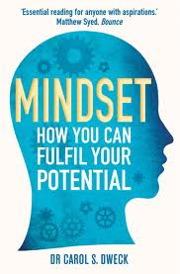
Growth Mindset
Carol Dweck (Stanford)
Growth Mindset versus Fixed Mindset
If you believe you can improve intelligence, you can
If you don’t believe it… you can’t
This has been extended to other domains
This course is based on the idea that people can increase their intelligence
Notes:
Positive psychologist Carol Dweck has written extensively about the idea of the growth mindset. Her research compares people with growth mindsets to people with fixed mindsets. Dweck has concluded that if people maintain a growth mindset, that is, if they believe they can improve and increase their intelligence, they are often able to do so. Also, the corollary is true as well. If people have a fixed mindset and believe that traits such as intelligence are unchangeable, then for those individuals, they are. In her book, Mindset: The New Psychology of Success (2006) Dweck has carried this idea further to the areas of education, sports, relationships, and personal change.
This course is fundamentally based on the premise that we are all born creative, but through experiences we become fixed on the idea that we are not creative or that creative work is primarily based in the arts. In the course I am developing I plan to dispel this idea and help students rediscover their creativity and learn new strategies to nurture and grow their capacities for creative work, in short for students to develop a growth mindset around their creativity.

Slide 21
Thinking Fast and Slow
Daniel Kahneman
System 1 – Thinking Fast
System 2 – Thinking Slow
Creativity is part of system 1
Effective creative problem solving requires going back and forth between the two systems
Kahneman finds a relationship between positive emotions and creative thought.
Notes:
According to Daniel Kahneman (2011) there are two kinds of thinking. He describes them as System 1, or thinking fast and System 2, or thinking slow. In System 1 the brain is constantly surveying the environment and acts quickly on opportunities, responds to dangers, and creates impressions very quickly through short-cuts and heuristics. System 1 is prone to many mistakes and errors on the side of caution. Most of the time we work in System 1 and it is effective because we are accustomed to working in this mode and have created rules to work within this system of thought.
Kahneman explains in great detail how Systems 1 and 2 work together to make decisions and how often one system can misinform the other, leading to errors in thought. In this regard, Kahneman makes a connection to creativity. He describes creativity as operating in System 1 and, like the positive psychologists, asserts there is a connection between happiness and positive mood and creativity:
Mood evidently affects the operation of System 1: when we are uncomfortable and unhappy, we lose touch with our intuition…. A happy mood loosens the control of System 2 over performance: when in a good mood, people become more intuitive and more creative but also less vigilant and more prone to logical errors. (Kahneman 2011, 69)
I agree there may be a relationship between creativity and System 1 and positive emotions as Kahneman asserts; however, I would argue that creativity needs a balance of System 1 and System 2 thinking.

Slide 22
Bringing Together Ideas
Operational definition of creativity
Originality
Applicability
Adding Eastern ideas
Personal fulfillment
Importance of contemplative reflection
Emphasis on new insights as well as product
Notes:
In the context of this course, my operational definition of creativity emphasizes two of its key aspects - originality and applicability. While these two concepts are basic to the western notion of creativity, I am also planning to develop and add to this definition to include eastern ideas of personal fulfillment and the importance of contemplation in seeing the connectedness of things as the course examines different aspects of creativity and creative persons.
By integrating the eastern view of self actualization, the western view of everyone is creative with the right opportunities and nurturing, as well as ideas from positive psychology that a healthy well being can improve your creativity, I believe that students will construct more complete understandings of creativity and its importance to every individual’s life. At the same time, I recognize that the context of this course is within a business-focused certificate program, so I will place a high degree of emphasis on the usefulness of creative solutions generated.

Slide 23
Reflections on the Development of the Creative Thinking Course
The course…

Slide 24
Creative Discovery
Course Units
Course Themes
What is creativity?
How am I creative?
Understanding creativity
Managing the creative process
Putting it all together
Creative Process
Creative People
Creative Environments
Finding Your Passion
Notes:
This course has four themes. They are: (1) Creative Process, (2) Creative People, (3) Creative Environments and (4) Finding Your Passion. Each of these themes will be addressed in an iterative fashion throughout the course. I believe in order to develop an understanding of the nature of creativity students will need to be introduced to and begin to develop each of these themes.
They will also need several opportunities to practice and reflect on the four themes in order to understand its importance to the nature of creativity and the creativity within themselves.

Slide 25
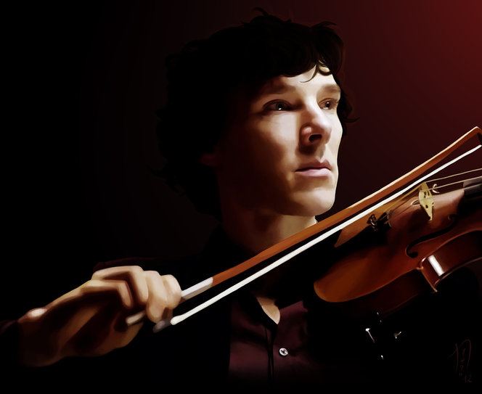
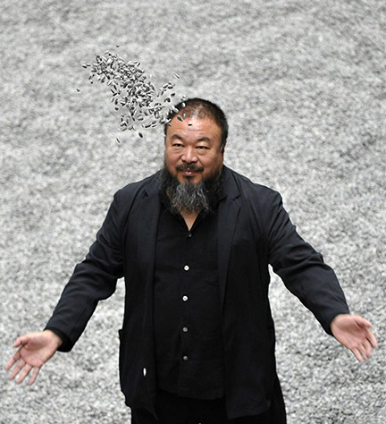
Major Assignments
Creativity Definition
Reflective Journal
Artist Dates
Weekly Activities - Sci-fi Scamper
Creative Person Research
Problem of Personal Interest
Notes:
Creativity Definition Assignment
Students will be asked to define the term creativity
This will provide baseline assessment of their understanding and pre-conceived notions
Over the course of the semester students will edit and expand this definition in small groups
Promotes ongoing discussion of ideas
Creates synthesis of course concepts
Students reflect on developing understanding across drafts
Students initial definition will be done in pairs in order to help them clarify their own ideas through discussion. After that point it will become an individual assignment with students expanding their definitions with course readings for example when students read about the eastern view of creativity they will be prompted to refelct upon their definition and describe how it addresses the eastern view of creativity or will be asked to expand their definition to include eastern concepts. Students will be asked to site sources and the end product will be a short essay on the nature of creativity.
Reflective Journal – based on the morning pages – content is not revlevant it is just that the student gets in the habit of reflecting
One strategy to improve their understanding of their own creative process is to reflect on what strategies work and what strategies do not work. They can purchase a physical journal or create a digital one to write down their ideas, reflections on readings, drawings etc. And I will advise them to keep their journal (physical or digital) accessible to them as much as possible during the semester in order to write down any ideas they have, at any time, about anything, and anywhere. This is an easy way to help them become aware of their own creative process, new ideas, and provide a simple way to return to their ideas later. The journals will be handed in at the end of the semester and graded primarily on volume, not quality. Writing is required for the journal, however sketching, drawing, doodling, diagramming is also encouraged.
Artist Dates
As part of my creative journey creating the course I have found the artist dates to be the most beneficial to the development of my creativity. The Artist Date is an activity developed by Julia Cameron from the Artist’s Way. In this assignment, students will engage in the Artist Dates on a weekly basis. An Artist Date is setting a block of time, at least two hours, in which the student will do something they enjoy doing by themselves. Students could go to a movie, go for a walk, play an instrument, go shopping, they could do just about anything, but they must do it alone. Students will summarize their weekly artists date in a paragraph or two each week using the Journal feature in Bb. The Artist Dates will provide an opportunity for self-intimacy. Often when we are feeling creatively blocked it is because we are doubting our potential to create. The Artist Date provides a positive avenue to do something you enjoy for yourself and your creativity. It re-connects you with your inner artist and it is helpful in becoming mindful of what makes you happy and content.
SCI-fi Scamper
Is an example of a group activity students will engage in to practice working as a group to find creative solutions. Students will read an excerpt from The Left Hand of Darkness by Ursula LeGuin, view a PowerPoint presentation with the main ideas extrapolated regarding the culture of Gethen (fictitious planet in the story), and they will view a map and Wiki-pedia entry on the book. T
he Left Hand of Darkness is a science fiction novel about a planet, Gethen, where it is always winter and the technology is more purposefully primitive than on earth. The most significant difference is that the inhabitants are on a cycle where they change from male to female. Using this story will force the students to be creative because they will not have any preconceptions of how things should be. Students will be forced to think about the cultural differences without gender differences on Gethen. They will then be asked to create something novel and applicable for Gethenian use. This could be a piece of technology, clothing, architecture, or any other useful tool for the planet. I believe this activity will help the students stretch their creativity and practice their skills in more abstracted way.
This activity will use the popular SCAMPER creative problem solving strategy. SCAMPER is an idea generating activity that uses a checklist of questions to spur new ideas by making connections to seemingly unrelated ideas or objects. In this activity students will practice brainstorming, stretching their thinking by looking at different perspectives and making connections to things that appear to be unrelated. The activity also works well in groups; group members can split up the activities or do them together and compare results. Although I have used SCAMPER in the past, I did not use this strategy to come up with the idea for the Scifi Scamper activity; I actually made the connection one week during one of my Artist Dates.
Cologne that changes with your hormones. - fur coat
The Creative Person project is a research paper on a creative person
Students will be assigned readings from Uncommon Genius and asked to write a descriptive profile of someone they consider to be a creative person, including an analysis of their creative process and relate it back to their own creative process.
Problem of Personal Interest Project (PPIP) One long-term project in this class will be the identification of a problem of personal interest to the student. This may be a business problem, an academic problem, or a problem related to the students’ personal creative process or unique interest. Students will approach this problem in stages over the course of the semester helping them to identify a practical problem requiring a creative solution while working through a variety of activities designed to help understand and boost their creative processes.
This assignment will be chunked into four sections that are aligned with four of the five units in the course. In unit 2, students will work through activities that will help them identify their passion. In addition to finding their passion they will engage in activities that nourish their creativity and identify what values are important to them. Finding your Passion theme paper will be a reflective paper that will talk about their process in finding their passion and the importance of participating in projects that are important to them. I believe letting the students identify their own problem to solve will increase motivation and engagement in the activity.
In Unit 3, students will read and discuss the nature of creativity and the impact of positivity and ways of thinking that nurture creativity. They will also engage in activities to help them look at their problem through different lenses and perspectives. Students will continue to be exposed to different types of activities to boost their creativity. In this section of the PPIP they will write about the different types of activities they are using to solve their problem and how change in perspectives and thinking styles are affecting the way they look at problems.
In Unit 4, students will be exposed to ideas regarding nurturing spaces and incubation; by engaging in discussion and activities they will discover the spaces and learning styles that encourage their creativity and flow. Students will continue to participate in activities to boost creativity, including working in groups and making decisions as a group. In this section they will write about how they manage their own creative process and how they came up with the solution to their problem.
Finally in Unit 5, students will reflect on their process and choices while developing a creativity plan for the future. After writing their creativity plan, students will take each section of the PPIP writing assignments and create one paper or Problem of Personal Interest Project paper. To do this they will need to connect the sections by writing some transitions and additional insights. In the end the paper should be in substantial in length and considering the demographics of the students who may be taking this course, the paper itself will be a significant achievement.Assessments of the PIPP will be based on their problem identification and solutions provided, but it will also be based on their own assessment of originality and applicability.

Slide 26
Artist’s Way – Julia Cameron
Intentions
Revelations
Experience the Artists Way as an Artist
Build My Own Creative Confidence
Re-discover my self as an artist
Need for Focused Attention
Self-doubt seems to always show its ugly head
Re-identified as a creative person
Supportive Network
Notes:
According to Julia Cameron the primary purpose of the Artist’s Way is to put people in touch with the power of their own internal creativity. (Cameron, pg 207) My intention when I began the twelve-week course was to engage in the program as an artist and experience the program by developing my creativity through expressing myself through photography.
During the process I discovered even though I was taking pictures on the Artist’s Dates, I was thinking and making new connections for the development of my course instead of developing and unblocking as an artist. This was a powerful realization for me, creativity needs focus and attention. My attention was focused on the development of the course and not as an artist As I begin to teach this course and students react to the assignments, I will continue to make changes and reflect on the parts that are working and not working so well.
In addition, I learned that self doubt is a normal feeling and through reflection exercises (practiced in the Artist’s way) you can put your censors in check through reflection
I plan to continue to practice the tools I learned in The Artist’s Way and change my focus to my photography so that I can experience the program as an artist as well as a thinker. This continued work as an artist and thinker will provide me with the experience and a depth of knowledge about creativity and the creative process that will continue to enlighten me and provide guidance for my students.

Slide 27
Continuing the Journey: Next Steps
In reflective practice we must continually think about our thinking
Use these reflections to improve practices
This will lead to mindfulness
Through reflective practice: identify passions; overcome block; improve practice
Notes:
In reflective practice we are continually thinking about our thinking; not only looking objectively at what has transpired, but also including personal reflections or relevant experiences from our work or personal lives and possibly from different contexts that apply to the current situation. Most importantly, these reflections should be continually used to develop and improve the practice. I believe if you develop a habit or process that works for you, you should continue to review your practice whether you are learning new ideas, looking at your daily work environment and actions or your personal interactions with people. This habit will help you grow and become more mindful. This process of reflection applies to creativity, for it is through reflective practice that an individual can process and identify their passions, overcome blocks and improve their practice through consideration.

Slide 28
Learn More about the Creative Process while Developing a Creative Thinking Course
Continued Research on Creativity
Develop My Own Creativity
Review other Creative Thinking Courses
Synthesize What I Have Learned in CCT
Continue to Learn more about the Creative Process
Continued Creativity Research
Continued Developing My Own Creativity as an Artist and Thinker
Continued Reflective Practice my Creative Process and Teaching
Build a Support Network for Teaching a Creative Thinking Course
Continuing the Journey: Next Steps
Notes:
Thank you for your kind attention. ☺

Slide 29
Bibliography
Compton, W. C. (2005). An Introduction to Positive Psychology. Wadsworth.
Csikszentmihalyi, M. (1990). Flow: The Psychology of Optimal Experience. Harper Collins: New York.
Csikszentmihalyi, M. (1996). Creativity: Flow and the Psychology of Discovery and Invention. New York: Harper Collins.
de Bono, E. (1970). Lateral Thinking . New York: Harper Perennial.
Flatow, I. (1992). They All Laughed... From Light Bulbs to Lasers: The Fascinating Stories Behind the Great Inventions That Have Changed Our Lives. New York: Harper Collins.
Gardner, H. (1993). Intelligence Reframed. New York: Basic Books.
Gardner, H. (2006). Multiple Intelligences. New York: Basic Books.
Kahneman, D. (2011). Thinking, Fast and Slow. New York: Farrar, Straus and Giroux.
Kaufman, J. C., & Sternberg, R. J. (2010). The Cambridge Hanbook of Creativity. New York: Cambridge University Press.

Slide 30
Bibliography con’t
Michalko, M. (2006). Thinkertoys. New York: Random House.
Michalko, M. (2011). Creative Thinkering: Putting Your Imagination to Work. Novato: New World Library.
Robinson, K. (2010). Changing Education Paradigms. Retrieved October 29, 2012, from TED Talks: http://www.ted.com/talks/ken_robinson_changing_education_paradigms.html
Seely Brown, J., & Thomas, D. (2011). A New Culture of Learning: Cultivating the Imagination for a World of Constant Change.
Seligman, M. E. (2011). Flourish: A Visionary New Understanding of Happiness and Well-being. New York: Free Press.
Shekerjian, D. (1990). Uncommon Genius. New York: Penguin Books.
Sternberg, R. (2003). Wisdom, intelligence, and creativity synthesized. New York: Cambridge University Press.
Weber, B. (2011). Childhood, Philosophy and Play: Friedrich Schiller and the Interface between Reason, Passion and Sensation. Journal of Philosophy of Education, Vol. 45, No. 2.

Slide 31
Reflecting on Developing a Creative Thinking Course for Community College Students
Noreen McGinness Olson CCT Synthesis, Spring 2013

Slide 32
Scope and Sequence
Reviewed other syllabi course syllabi
Determined level of content appropriate for community college audience
Emphasis making it meaningful for students
Engaging pedagogy
Connections to business/entrepreneural content where possible

Slide 33
Online Delivery Format
Offered fully online via Blackboard
I have trained over 100 faculty to teach online
Worked backwards from learning outcomes
Take advantage of online resources and collaborative tool
Hope to offer hybrid version to include face-to-face strategies
Notes:
When it was first suggested to me that I put Creative Thinking online, I was not sure it was the right idea. While I understood the reasoning that a new, untested course for a new certificate program would be more likely to get the necessary enrollments to run if it was available to the widest population of students, I had not initially pictured my course as online. My own study of creative thinking in CCT had been primarily face-to-face, and I had found it to be engaging and effective. Also, when I mentioned to people that I would be teaching the course online, it was not uncommon for me to hear responses such as, “Really? Do you think this course can be taught online?” Fortunately, I do.
For a large part of my career at Middlesex, I was part of the team that worked with faculty to put their courses online. I collaborated with over a hundred instructors from a variety of disciplines to help them with the not only the mechanics, but also the pedagogy of online instruction. The online learning program at Middlesex started in 1996 and from its beginning was rooted in social constructivist learning theory.
Over the years of working in that program, I participated in many helpful professional development programs for teaching online that have provided me with a framework for the kind of online instruction that is effective with community college students. Online courses that work well with our students are highly engaging, ask students to apply course content to meaningful contexts, and allow for social interactions around course topics to help students to develop more complex understandings.
To make the course engaging, I realize that I will need to make it clear to students why studying creative thinking will be of interest to them. Assignments will need to be connected to contexts that the students find understandable, interesting and important. Moreover, students will need to interact with each other on a weekly basis.
Hybrid version would mean that we would have 3 required face to face meetings. If a student could not make the meeting then there would be an alternative assignment or they could be brought in by skype.

Slide 34
Grading
Weekly Assignments (Artists Dates, Theme Papers and Activities) 20%
Creativity Definition 15%
Discussion Board Participation 20%
Weekly Journal 20%
Problem of Personal Interest - Final Submission 25%
Total 100%

Slide 35
Design Thinking
Methodology for solving problems. Includes using:
Empathy
Creativity
Rationality
Notes:
describing a particular style of creative thinking-in-action
As a style of thinking, design thinking is generally considered the ability to combine empathy for the context of a problem, creativity in the generation of insights and solutions, andrationality to analyze and fit solutions to the context.

