Slide 1

My Journey to Develop an Innovative Approach to Unplanned Pregnancy
Gina Dillon Podolsky
Critical & Creative Thinking
The University of Massachusetts Boston
Spring 2011

Slide 2


Slide 3
Statistically, 50% of you were UNPLANNED Babies

Slide 4
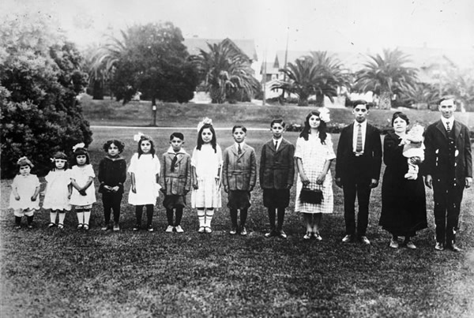

Slide 5
AND in the 50-80s big families were playful and rambunctious and FANTASTIC

Slide 6
Today, the PROBLEM with Unplanned Pregnancy is… fragile families do not have the extra resources to dedicate to parenting
Unplanned pregnancy costs U.S. taxpayers
$9.1 BILLION ANNUALLY

Slide 7
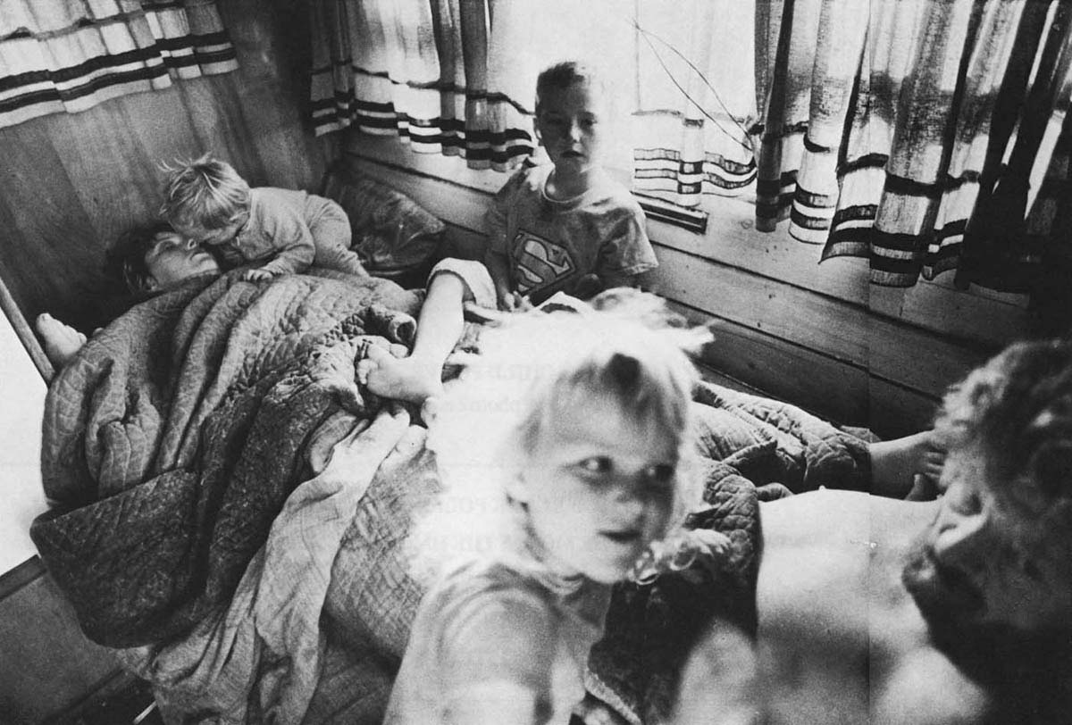

Slide 8
FRAGILE FAMILIES are young, under-educated, with unstable partner relations who produce MORE CHILDREN than other demographics

Slide 9
UNFORTUNATELY…
INCREASING income disparities and economic hardship make it difficult for parents to provide a solid life platform for multiple
CHILDREN

Slide 10

UNPLANNED PREGNANCY
ABORTION
DRUG
ABUSE
UNDER
EDUCATED
MEDICAID
FOSTER
CARE
SYSTEM
WASTED TAX DOLLARS
DIVORCE
INCARCERATION
CHILD
ABUSE
THE EXPENSE OF CRIME

Slide 11
There is a GREAT threat, in the near future, that there will be FEWER social safety programs for U.S. families since the
GREAT DEPRESSION

Slide 12
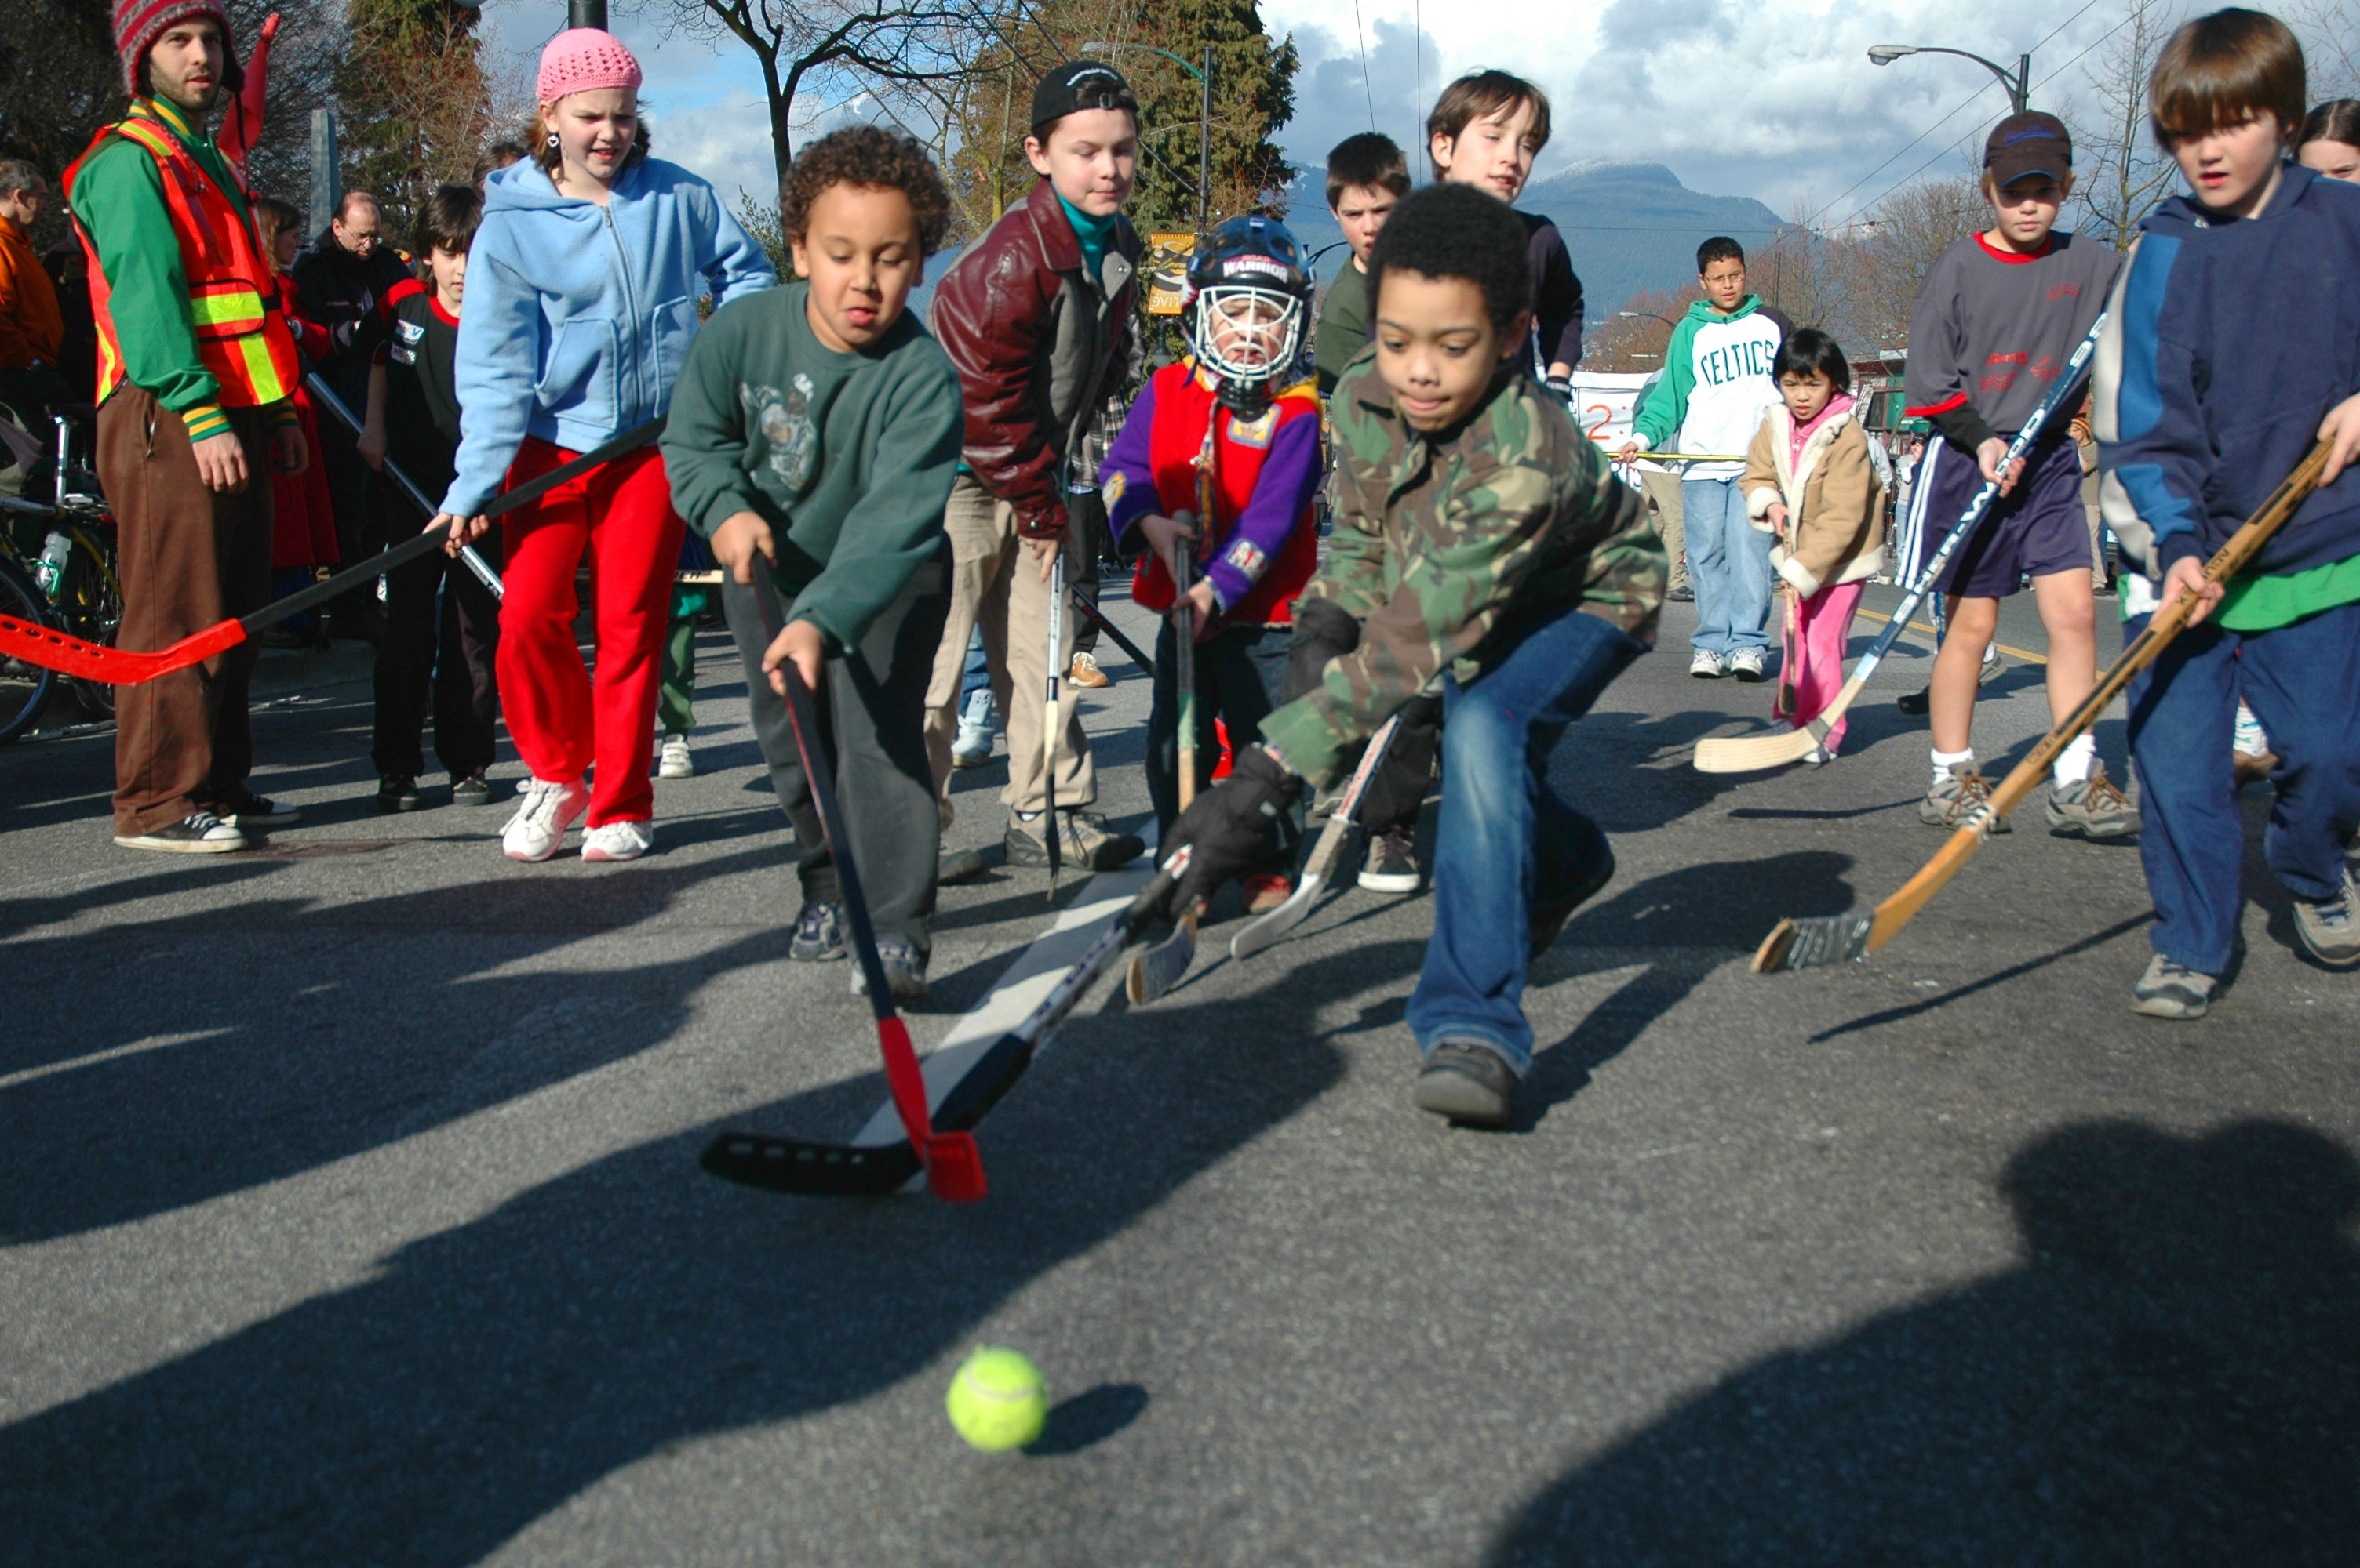

Slide 13
WHICH MEANS… there will be little help for needy families
AND Young AMERICANS will need to be
EXTRA VIGILANT in creating
RESPONSIBLE LIFE PLANS

Slide 14
SO…WHAT’S THE BIG IDEA?
AND how did it begin?

Slide 15
My FINAL for Creative Thinking
“Roadside Art on Route 66” WASN’T inspiring
ME

Slide 16

So while DANCING…

Slide 17
…to GUNS N’ ROSES

Slide 18

I had an…

Slide 19
That took me back to being a teen

Slide 20

with big dreams…

Slide 21

How can we CREATIVELY address
Unplanned Pregnancy?

Slide 22
My Inspirations
Malcolm Gladwell
The End of Poverty
Freak-
onomics
C.R.A.C.K
Oprah
Esther Duflo
Richard Florida
Facebook
LARC
Maslow
City of St. Louis
Child Abuse
The Komen Foundation
Abortion
Strength of Weak Ties
Teen Brain Study

Slide 23
My RESEARCH shows…

Slide 24
America leads all developed nations in
UNPLANNED PREGNANCY

Slide 25
Statistically, when adjusted for average use, 5% of the women in this audience will become pregnant if she isn’t taking her birth control pill regularly

Slide 26
The FRONTAL LOBE of the average BRAIN isn’t fully developed until our mid-20’s
Until then we are more likely to participate in RISKY BEHAVIOR no
REGARD FOR CONSEQUENCES

Slide 27
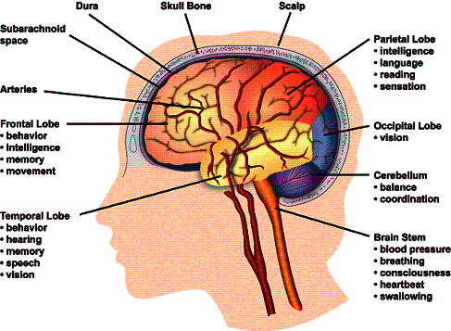

Slide 28
Granovetter’s
Theory of Weak Ties
Weak ties are best for networking
Strong ties have over-lapping influence

Slide 29
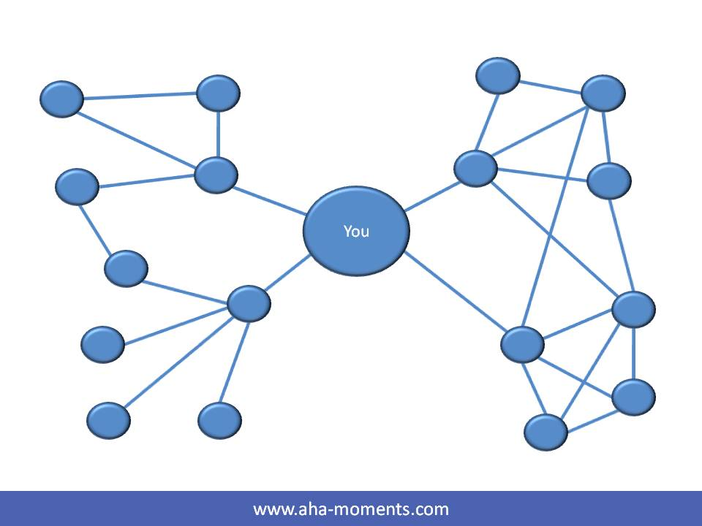

Slide 30
Studies show that HUMAN BEHAVIOR can be MODIFIED through the use of INCENTIVES

Slide 31


Slide 32
Critical & Creative Thinking Skills
SCAMPER
Dialogue
Reflective Practice
Mind Maps
Strategic Planning
Critical Analysis
Socratic Q’s
Supportive Listening
KAQ

Slide 33
I developed a THEORY that due to the controversy of targeting teens my organization should address the 18-29 population

Slide 34
Let’s STOP and take a closer look at how
I brought these CONCEPTS together to CREATE….

Slide 36
I contacted the
President of Planned Parenthood in Amarillo, TX to see if combining Incentives, Social Media and LARCs was interesting to them
Yes, they agreed.

Slide 37


Slide 38
And a
$100,000 grant from the
Robert Wood Johnson Foundation was provided to help launch a research project on my concept
WITH A FEW CONDITIONS…

Slide 39

Teens only
No gift bags
No LARCs

Slide 40
I said, No Thank You

Slide 41
Part One
Contraception

Slide 42
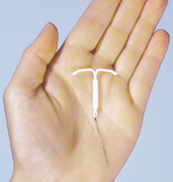
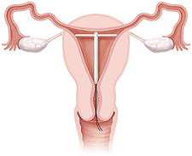
The intrauterine device (IUD) and other LONG-ACTING REVERSIBLE methods are up to 99.9% EFFECTIVE and last for up to 10 YEARS

Slide 43


A quick Analogy, the PILL is to CONTRACEPTION…
what the 8 track
is to music

Slide 44
HOW WILL WE ENCOURAGE WOMEN TO SWITCH?
With INCENTIVES in the form of donated merchandise, professional DEVELOPMENT opportunities, CYBER SUPPORT and other activities that encourage
LIFE PLANNING

Slide 45
Part Two
Incentives

Slide 46


I brought these ideas TOGETHER
C.R.A.C.K pays crack addicts $1,000 to undergo permanent sterilization
Oprah gives away merchandise and makes people feel good.

Slide 47
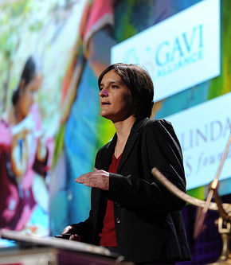
According to the Research of
Esther Duflo
The women of India will walk miles into town to vaccinate their children for a small bag of beans

Slide 48


Slide 49
WOULDN’T IT BE NICE IF SPONSORS VIA GROUPON DONATED MERCHANDISE TO CHARITY FOR EVERY 100TH PRODUCT SOLD?

Slide 50
PART THREE
Tapping Into Personal Aspirations

Slide 51
It is simply not enough to ENCOURAGE the use of CONTRACEPTION. We need to encourage the practice of life planning through SUPPORTIVE VIRTUAL NETWORKS

Slide 52
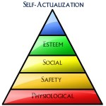
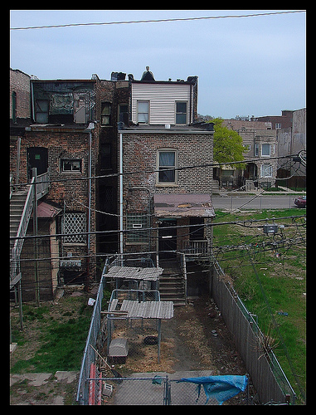
How do we EMPOWER people?
MASLOW’S HEIRARCHY OF NEEDS
JEFFERY SACHS
Lower needs must be met to reach self-actualization
Geographic isolation doesn’t have to be third-world country it can be an inner city neighborhood

Slide 53
It’s not what you DO for people, it’s how you make them FEEL. Maya Angelou

Slide 54
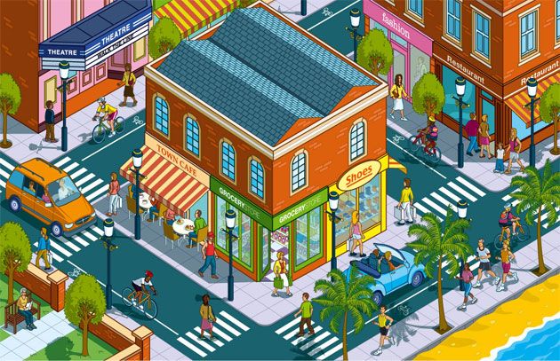
MALCOLM GLADWELL
&
Dubner and Levitt
“FREAKONOMICS”
Use STORY-TELLING to make complex issues easily UNDERSTOOD by the general population
RICHARD FLORIDA
“THE RISE OF THE CREATIVE CLASS”
Believes that the synergy of a community is as important to its development as the structural components

Slide 55
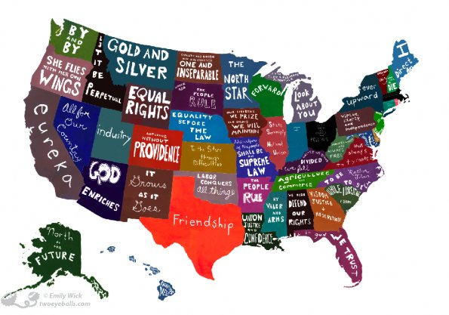
Creating Supportive Communities

Slide 56
Part Four
Community Building & Technology

Slide 57
The founders of
THE SUSAN B KOMEN FOUNDATION invented the SALAD BAR and his wife (Susan’s sister) was a
NEIMAN MARCUS marketing executive this helps to explain their success…

Slide 58

COMMUNITY BUILDING & MARKETING
ARE THE BACK BONE OF
THE SUSAN KOMEN FOUNDATION

Slide 59
Community Building
Via
Facebook and Twitter

Slide 60
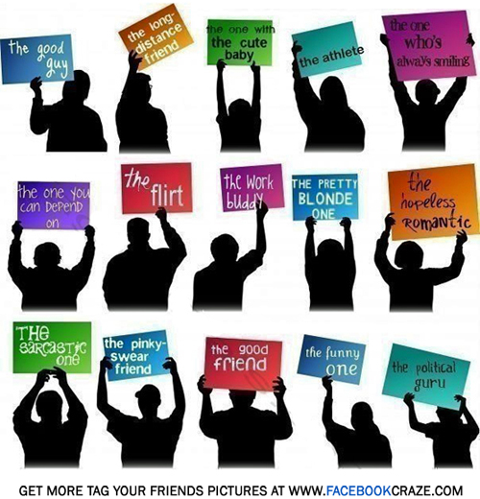

Slide 61
Millions of your closest friends whom you’ve never met

Slide 62


Slide 63
Donating MONEY is easy when it is directly billed to a CELLULAR account

Slide 64
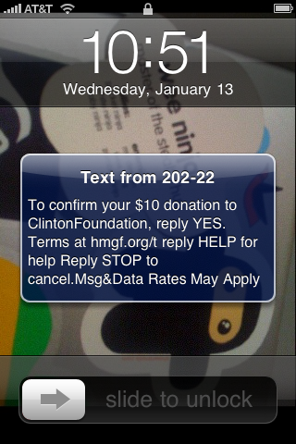

Slide 65
Part Five
Designing the Organization

Slide 66
I SCAMPERED a program design

Slide 67
It takes two to TANGO… so I decided Pennies for Pause will include GUYS

Slide 68

I was inspired by Lance Armstrong

Slide 69
So…PfP and TLJ merged

Slide 70
I created a COLLABORATIVE online community

Slide 71
I outlined the OPERATION of the organization

Slide 73
And organized a REWARD system

Slide 74
Incentives will be awarded based upon the amount of points earned
They can be saved up for larger items or spent as the participants please

Slide 75
The goal is to create a
SELF-SUSTAINING non-profit organization so I created LIFE. In a Note a professional announcement writing services that turns wedding, obituaries, anniversary announcements into WORKS OF ART

Slide 77
A portion of the PROCEEDS will go to PfP and LIFE will provide intern and writing positions for PfP participants
LIFE currently has 17 writers,
12 are young adults 18-29 the WRITERS can work from anywhere
INNER CITY to a small FARM COMMUNITY

Slide 78
Part Six
My Motivations

Slide 79
I want to create a more thoughtful society

Slide 80


Slide 81
I want tax payer $ invested in innovative programs that will benefit our country

Slide 82


Slide 83
I want to reduce child abuse

Slide 84


Slide 85
I want to reduce crime

Slide 86
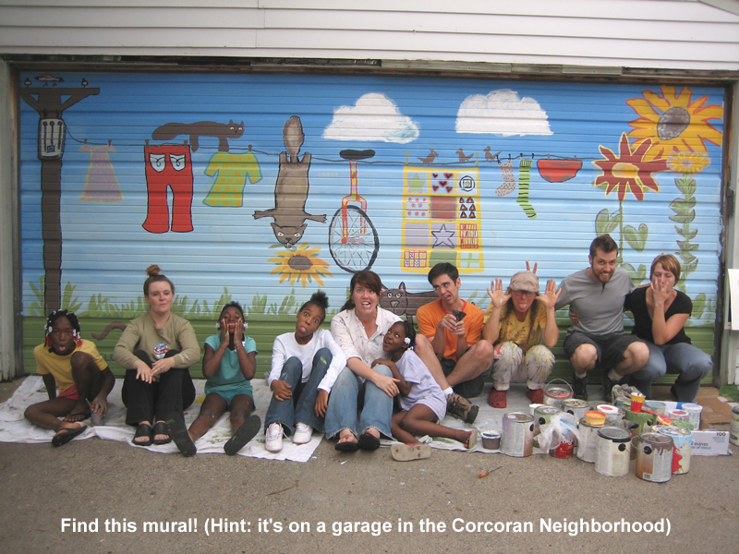

Slide 87
Most importantly…
I think my idea is a
SMARTER
CHOICE

Slide 88
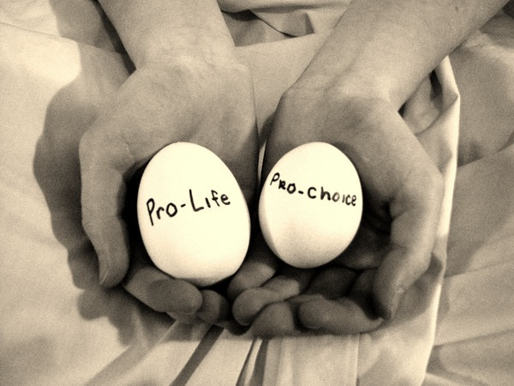

Slide 89
References
Music
(in order of appearance)
Mayer, John. Waiting on the World to Change. July, 2006. Aware Records
Guns n’ Roses. Sweet Child O’ Mine. August, 1988. Mike Clink
Johnson, Jack. Upside Down. February, 2006. Universal Records
The Talking Heads. And She Was. March, 1985. Sire Records
Mitchell, Joni. River. 1971. Reprise Records
Sources
Angelou, Maya. http://www.goodreads.com/author/quotes/3503.Maya_Angelou. Retrieved April 30, 2011
Armstrong, Lance. Live Strong. http://www.livestrong.org/. Retrieved April 30, 2011
C.R.A.C.K/Project Prevention. http://www.projectprevention.org/. Retrieved April 30, 2011
Dubner, S and Levitt, S. Freakonomics. William Morrow. April 12, 2005
Duflo, Esther. “Improving Immunization Rates Through Regular Camps and Incentives”. Abdul Latif Jameel Poverty Action Lab. 2004-2007. http://www.povertyactionlab.org/evaluation/improving-immunization-rates-through-regular-camps-and-incentives-india. Retrieved April 30, 2011

Slide 90
References
Davidson, H; Feldman, P.H; Laufer, F.N; Schluger, N.W; Telzak, E.E; Valentine, D.P. “The Effects of Increasing Incentives on Adherence to Tuberculosis Directly Observed Therapy” The International Journal of Tuberculosis and Lung Disease. Vol 4. Number 9. September 2000. pp. 860-865(6)
Duflo, Esther. “Improving Immunization Rates Through Regular Camps and Incentives”. Abdul Latif Jameel Poverty Action Lab. 2004-2007. http://www.povertyactionlab.org/evaluation/improving-immunization-rates-through-regular-camps-and-incentives-india. Retrieved April 30, 2011
The Economist. “Inequality in America: The rich, the poor and the growing gap between them”. June 15, 2006. http://www.economist.com/node/7055911?story_id=7055911. Retrieved April 30, 2011
Fragile Families and Child Wellbeing Study. Princeton University. http://www.fragilefamilies.princeton.edu/. January, 2009. Retrieved April 30, 2011
Facebook. Facebook.com. Retrieved April 30, 2011
Florida, Richard. ”The Rise of The Creative Class” Basic Books. April 30, 2002
Gladwell, Malcolm. http://www.gladwell.com/. Retrieved April 30, 2011
Granovetter, Mark S. “The Strength of Weak Ties” The American Journal of Sociology. Volume 78. Issue 6. May 1973
Groupon. http://www.groupon.com/. Retrived April 31, 2011

Slide 91
References
Guttmacher Institute. Differences in Teen Pregnancy Rates Among Five Developed Countries: The Roles of Sexual Activity and Contraception Use. Family Planning Perspectives. Volume 33. Number 6. Nov/Dec. 2001
It’s Just Your Future. http://www.itsjustyourfutureama.com/. Retrieved April 30, 2011
Juno. Fox Searchlight Films. Dec. 2007. Retrieved April 30, 2011
The Komen Foundation: Race for the Cure. http://ww5.komen.org/. Wikipedia: Nancy Brinker. http://en.wikipedia.org/wiki/Nancy_Goodman_Brinker. Retrieved April 30, 2011
Knox, Richard. “The Teen Brain: It’s Just Not Grown Up Yet” National Public Radio (NPR). March 2010. http://www.npr.org/templates/story/story.php?storyId=124119468. Retrived April 30, 2011
Life. In a Note. http://lifeinanote.com/site. Retrieved April 30, 2011
Mathes, Eugene. “Maslow’s Hierarchy of Needs as a Guide for Living” Journal of Humanistic Psychology. Vol. 21. Number 4
Mobile Giving Foundation. http://www.mobilegiving.org/. Retrieved April 30, 2011
The National Campaign. “By The Numbers: The Public Costs of Teen Child Bearing” http://www.thenationalcampaign.org/costs/national.aspx. Retrieved April 30, 2011

Slide 92
References
Pennies for Pause. http://www.penniesforpause.org/. Retrieved April 30, 2011
Planned Parenthood. “The I.U.D at a Glance” http://www.plannedparenthood.org/health-topics/birth-control/iud-4245.htm. Retrieved April 30, 2011
Robert Wood Johnson Foundation. Ten Outstanding Leaders Honored for Improving Health and Health Care in Hard to Reach Areas. http://www.communityhealthleaders.org/news_features/article/51532. Retrived April 30, 2011
Sachs, Jeffrey. “The End of Poverty: Economic Possibilities for Our Time” Penguin Press. December 30, 2005.
Twitter. http://twitter.com/. Retrieved April 30, 2011
Winfrey, Oprah. http://www.oprah.com/oprah_show.html. Retrieved April 30, 2011

