Slide 1
THROUGH THE WALL
I’m not
creative
You’re the
creative one
I’m not as
creative

Slide 2
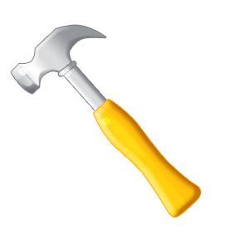
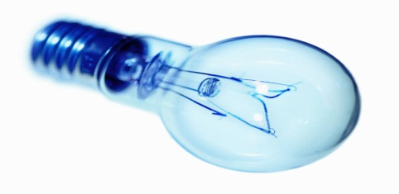
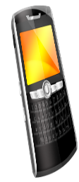
APPLIED CREATIVITY
Tools Toward Transformation
Teryl Cartwright
Synthesis presentation

Slide 3
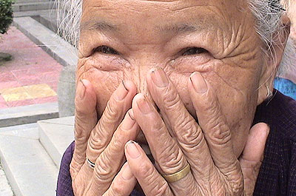
Finding Creativity inside the Box
Elderly
Autistic
Illiterate
Fitting In,
Not Just Standing Out

Slide 4
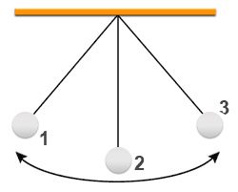
A-HA
A-Hint Accessed

Slide 5
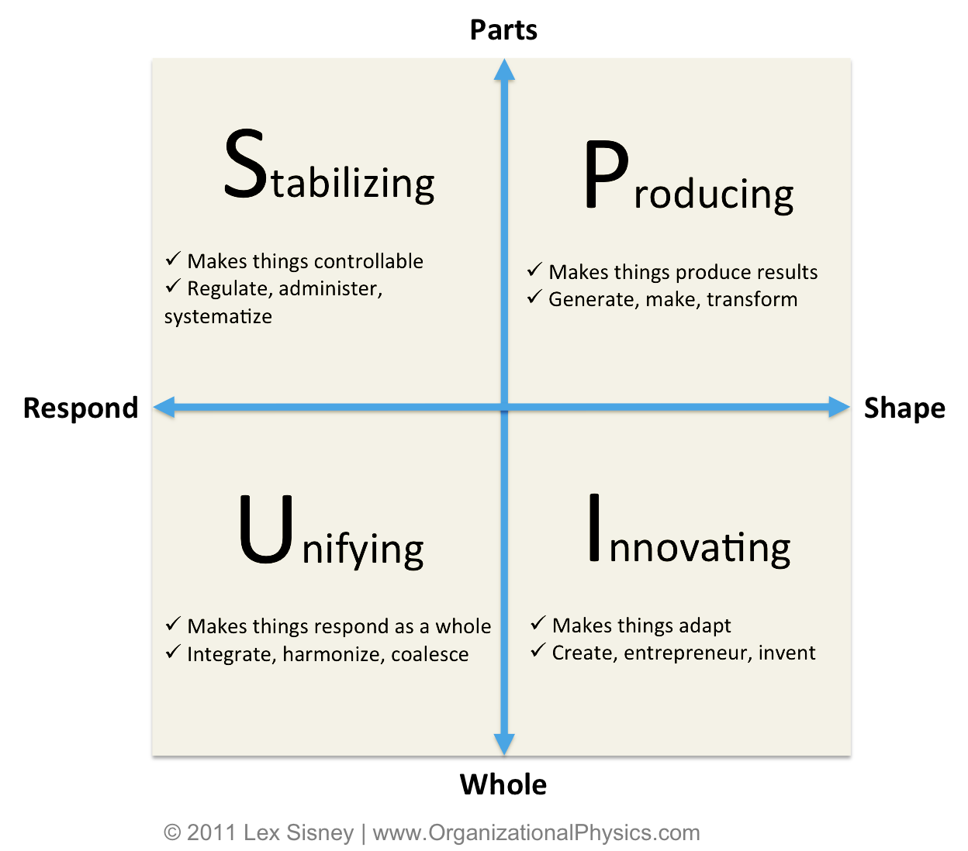
Four KINDS of Creativity

Slide 6
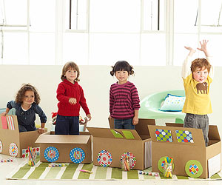
Personification of Creativity
Pioneer
Engineer
Diplomat
Inventor
Train of Thought

Slide 7
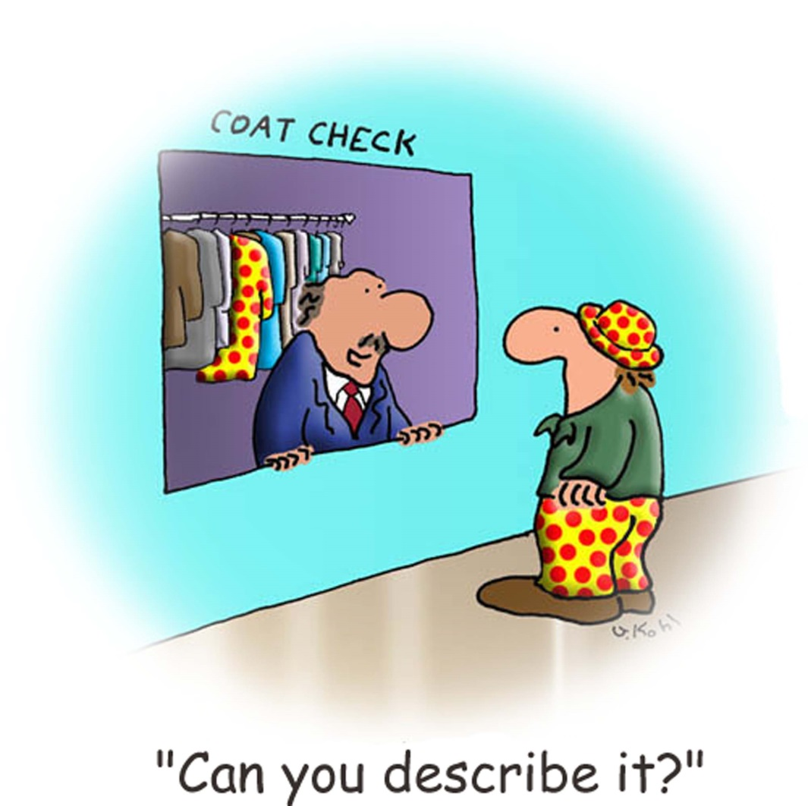
“Fit”
Adopt
Adapt
Create

Slide 8
Curriculum
Mini tour through my actual CCT courses:
Adopt IPED, Adapt IPED, Create IPED, Synthesis with pre and post instructor encouragement
Service component ATBL instead of PBL
Goes from instructor led to student taught incrementally, structured to self-directed
Students bring in items from outside to incorporate into curriculum including a homework assignment from another class

Slide 9
Future?
Action Research Creativity Processes of Research and Engagement Reflective Practice Synthesis Thinking Learning and Computers Creative Thinking, Collaboration and Organizational Change Dialogue Processes Bioethics Teaching Critical Thinking Writing across Curriculum

Slide 10
Visual bibliography
Slide 1 Wall sculpture found at http://uzar.files.wordpress.com/2009/03/another_brick_in_the_wall.jpg
Slide 2 Swiss army knife found at
http://www.amazon.com/Wenger-16912-Traveler-Speciality-Blade-Inch/dp/B000FNI94G
Slide 3 Box found at http://www.futilitycloset.com/category/technology/page/10/
Woman found at http://newageguineapig.com/2011/12/06/
Slide 4 Pendulum found at
http://www.thestreet.com/story/10343098/1/understanding-the-four-measures-of-volatility.html
Slide 5 PSIU chart found at http://organizationalphysics.com/2011/10/28/the-stages-of-the-execution-lifecycle/
Slide 6 Children in boxes found at http://declutterorganizerepurpose.wordpress.com/2011/02/21/teach-your-preschooler-good-behavior-through-games/
Slide 7 cartoon image license PURCHASED for educational use at: http://download.cartoonstock.com/1311641327355164
Slide 9: UMass Boston Beacon found at
https://twitter.com/UMBWHockey
All other images from Microsoft Word Clip Art

