Slide 1
A Better Way
A Theory of Transformative Collaboration Between Urban Schools and OST Programs
A Capstone Project by Caitlin McCormick
May 5, 2014

Slide 2
Energizer

Slide 3
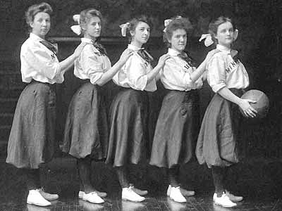
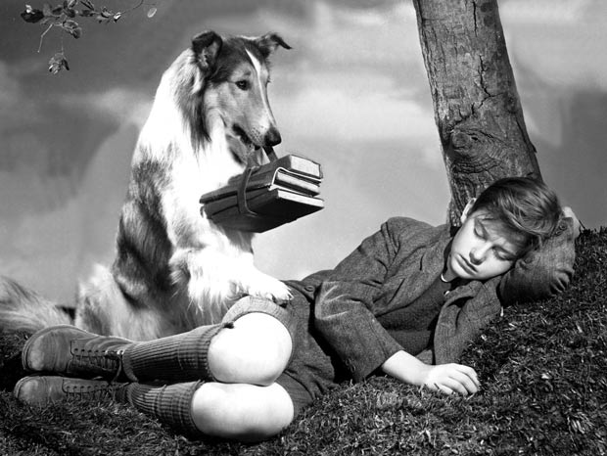
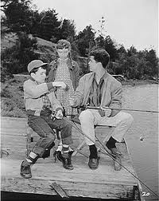
Afterschool Activities

Slide 4
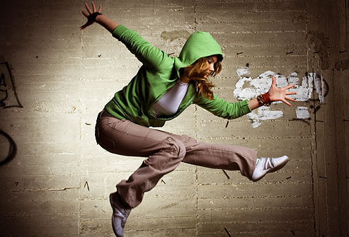
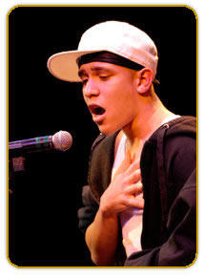
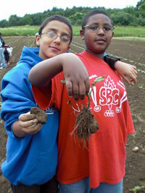

Slide 5
OST Programs

Slide 6
Achievement Gap

Slide 7
OST
Funding, necessity, & new research are pushing OST-school partnerships
Partnerships = challenges and opportunities

Slide 8
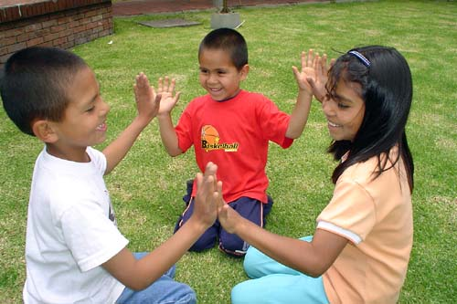
My Project
Why is it so hard?
How can we do it better?

Slide 9
A Project Map

Slide 10
The Central Disagreements
Goals
Student Behaviors
Professional Norms
Relationships
Space and Resources

Slide 11
Goals
School Day | OST
Primarily academic in nature Secondarily social-emotional | Primarily social-emotional Secondarily academic

Slide 12
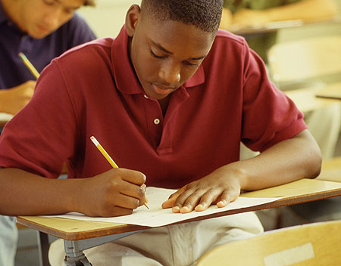
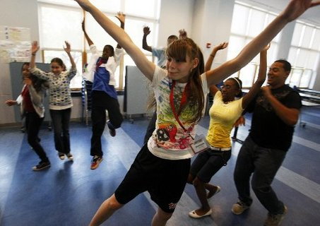
Student Behaviors

Slide 13
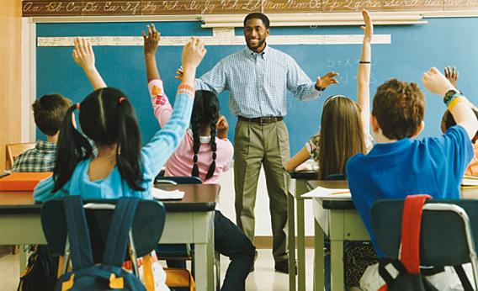
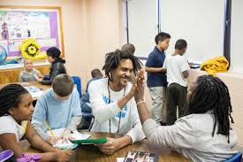
Professional Norms

Slide 14
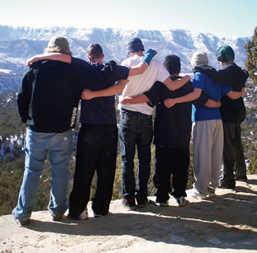
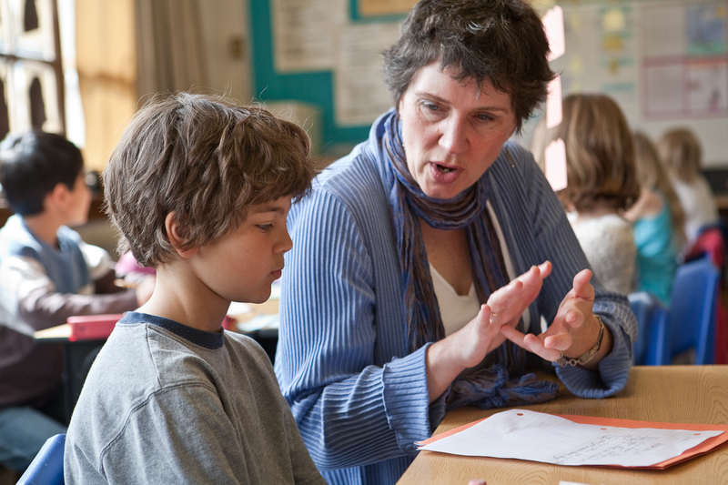
Relationships

Slide 15
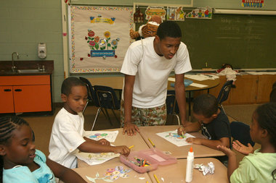
Space and Resources

Slide 16
School Day Primacy
Sixth-grader Johnny missed a test in Mr. Smith’s English class yesterday. During the afterschool program, Mr. Smith calls Johnny to his classroom over the intercom. Mr. Smith doesn’t know that Johnny is enrolled in the Film Club of his afterschool program. Johnny usually struggles in school because of a learning disability. School work is always hard for him, and as a result he acts out in class and often gets in trouble. But during Film Club, Johnny has discovered that he has a real talent for videography. He is respected for his artistic eye and his ability to work with the technology. Neither he nor his afterschool teacher knew he was going to be called by Mr. Smith, and they are in the middle of screening one of Johnny’s pieces that he is most proud of. Not wanting to disrespect the school, the afterschool teacher sends Johnny along to Mr. Smith’s classroom, despite his protests. Johnny trudges to Mr. Smith’s class.

Slide 17
Stronger Together

Slide 18
Central Agreements
1. Growth Mindset
2. Community
3. Reflective Practice

Slide 19
Growth Mindset
About students
About each other
About selves

Slide 20
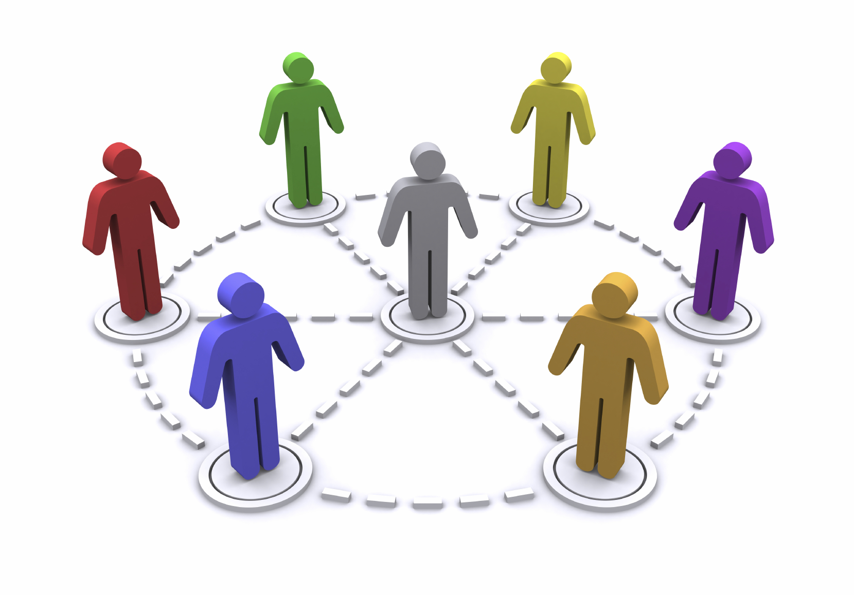
Community
We are all part of a whole
We must work together
We are all important
Youth need it
We need it

Slide 21
Reflective Practice
Agree to engage in reflection
Institutionalize it
Use it for all work together

Slide 22
Central Agreements
Collaborative Potential

Slide 23
Collaboration
Not just working well together…
Truly transforming through the process of collaboration.

Slide 24
Collaborative Potential
YOUTH NEEDS

Slide 25
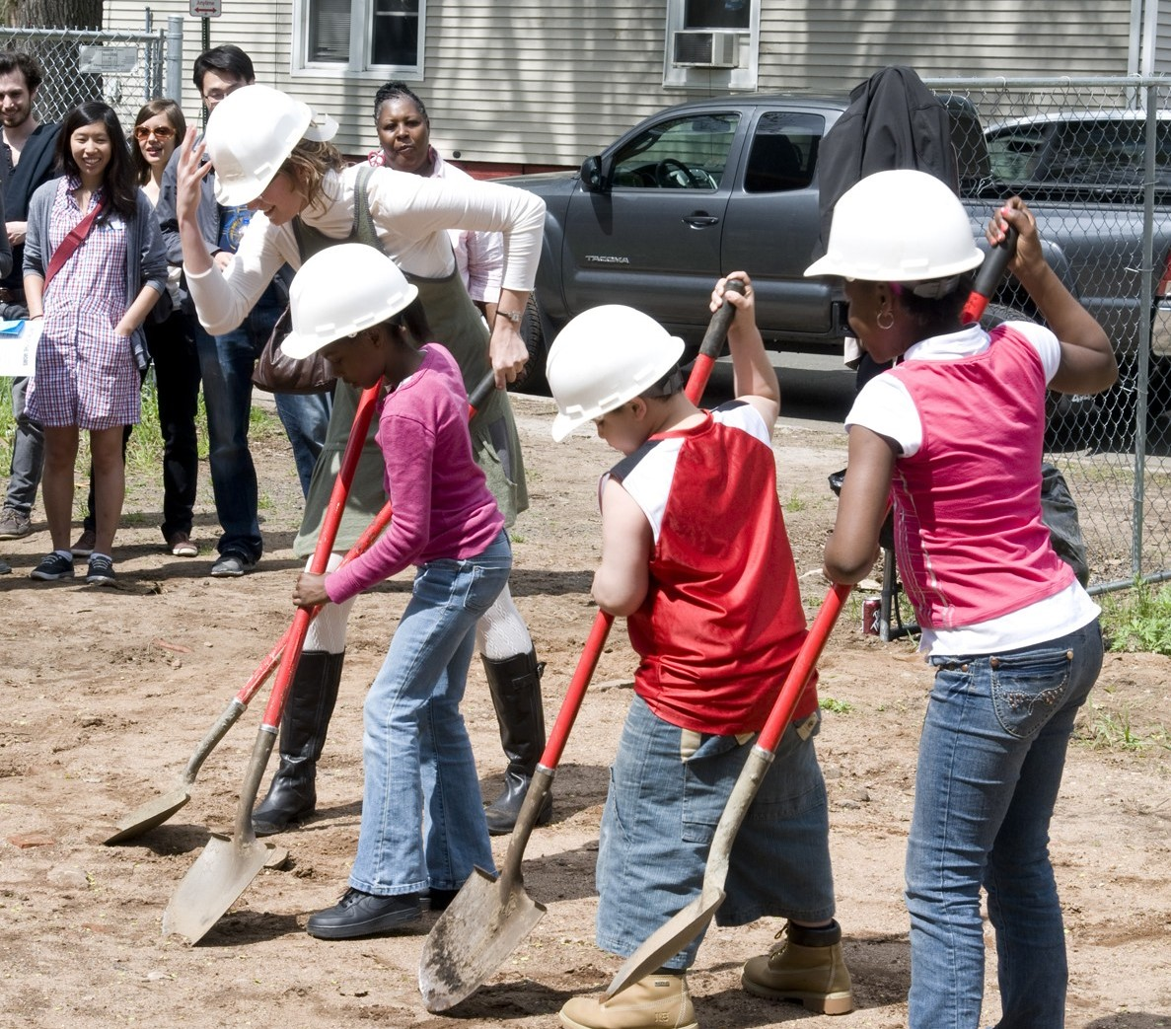
Collaborative Groundwork
DAY 1:
Trust
Community
Relationships
Exploring identity
Collaborative problem-solving
Honest discussion
Consensus-building

Slide 26
Collaborative Groundwork
DAY 2:
Uncover the Disagreements
Build the Agreements
Explore hidden beliefs
Understand unspoken values
Find shared goals
Identify strength in differences

Slide 27
Collaboration

Slide 28
