Slide 1
Reflective Practice in Behavior Analysis & Therapy
Rebecca Cornwell
MEd, LTET Candidate
Spring 2013

Slide 2
Process over Product...
What is Applied Behavior Analysis?
  What is Behavior Therapy/ABA Instruction?
  How I found myself in this field
Discovering how to best prepare for my career as a Board Certified Behavior Analyst
  How I used my Log of Hours
  Creating An ABA Program for Myself
  How/Why this test preparation is so different that any I have practiced in the past (e.g. ACT, SAT, MAT)

Slide 3
Find the Function, Then Intervene...
"The function of a behavior refers to the source of environmental reinforcement for it."
- Tarbox et al (2009, p. 494)
#1 Social Attention
#2 Tangibles or Activities
#3 Escape or Avoidance
#4 Sensory Stimulation

Slide 4
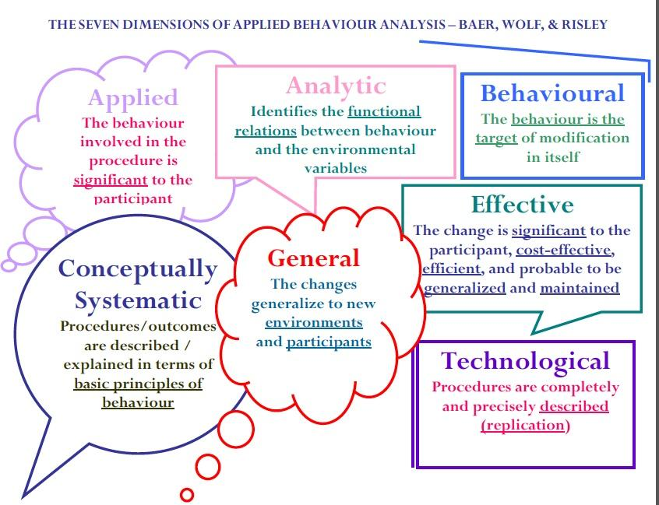
7 Dimensions of
Applied Behavior Analysis

Slide 5
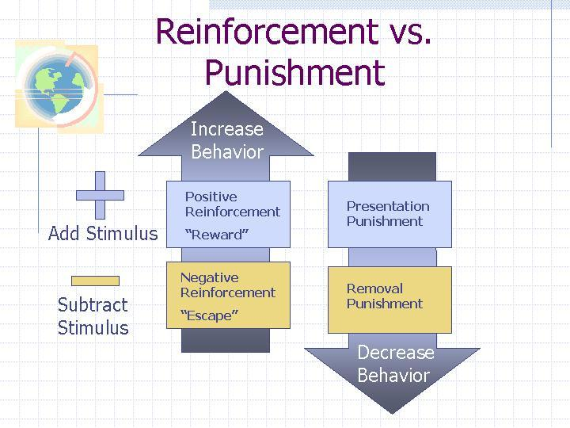

Slide 6


Slide 7
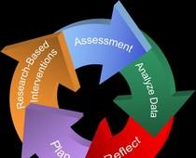
After determining the function...

Slide 8
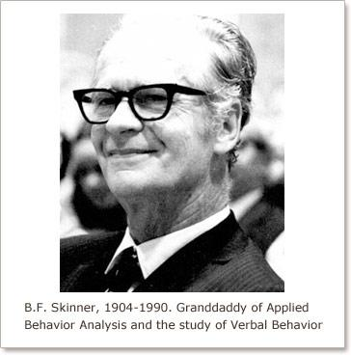
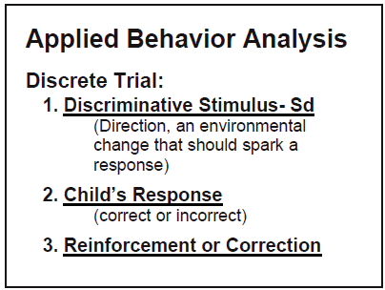

Slide 9
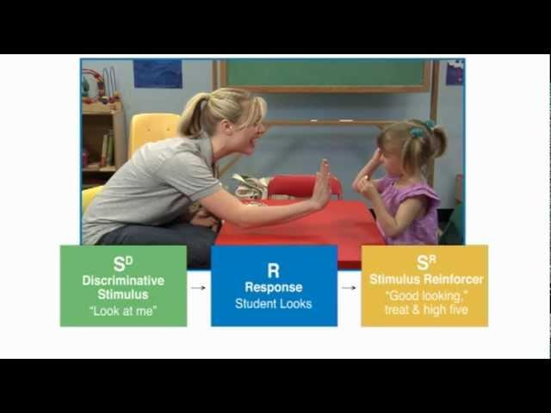
Discrete Trial Training

Slide 10
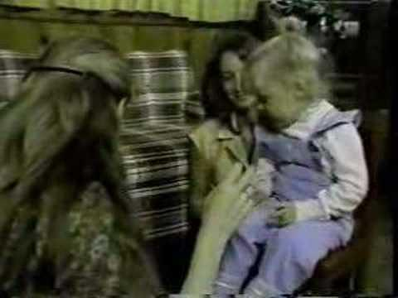
Early Ivar Lovaas Videos - 1981

Slide 11
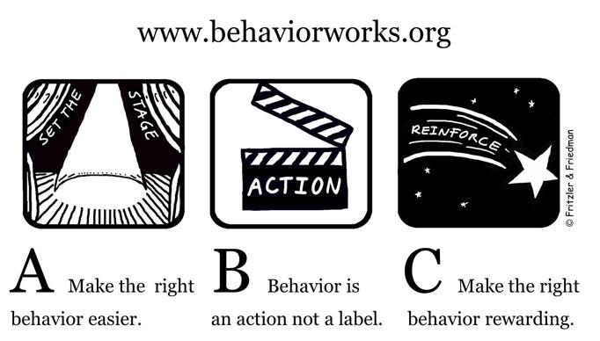
Antecedent > Behavior > Consequence

Slide 12
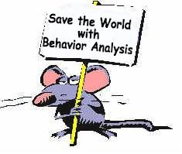
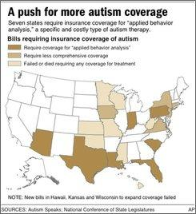
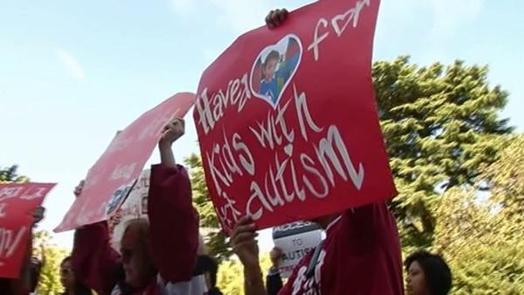

How I found ABA...

Slide 13




Slide 14
Log of Hours: Feb 1-April 30
Staff Meetings with Supervisors & Coworkers about Behavior Changes, Plan Modifications, and Conclusive Data
  Daily: M-F 7:30-7:45AM
  Weekly: Fridays, 2:30-3:30PM
Behavior Plan Modification Log with explanations for each change
Performing my first Functional Behavior Analysis
Writing and Implementing my first Behavior Support Plan
Implementing my first Parent Training sessions
Attending a conference

Slide 15
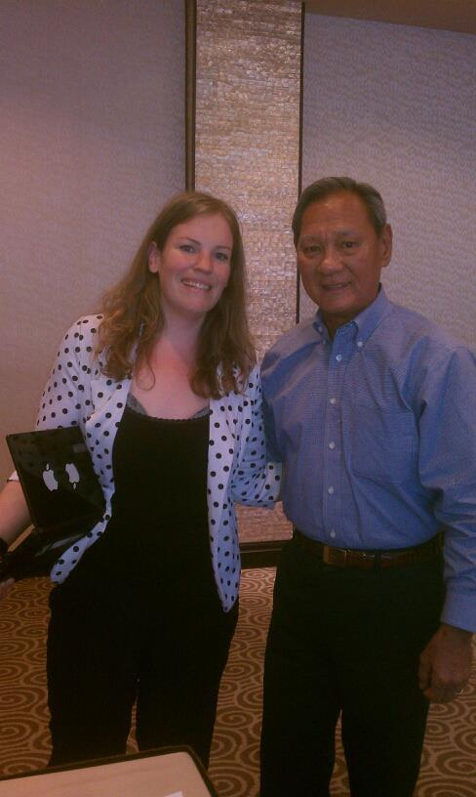
Cornwell & Iwata
April 26, 2013
In the field of Applied Behavior Analysis. Dr. Brian Iwata is the foremost researcher on functional analysis methodology.
This conference was about assessment-treatment continuum and translating research findings into practical application.

Slide 16
ABA Program for Myself
Positive Reinforcement Procedure
Sunday Study System
  2-4pm
  Behavioral Development Solutions Modules
Reinforcer:
  If successful 100% of the Sundays in the month, I will treat myself to an activity between $40-50 that I might not usually, automatically purchase
Data -
  February: 100% > Massage
  March: 100% > Pedicure
  April: 100% > Concert Ticket to see Ben Harper

Slide 17
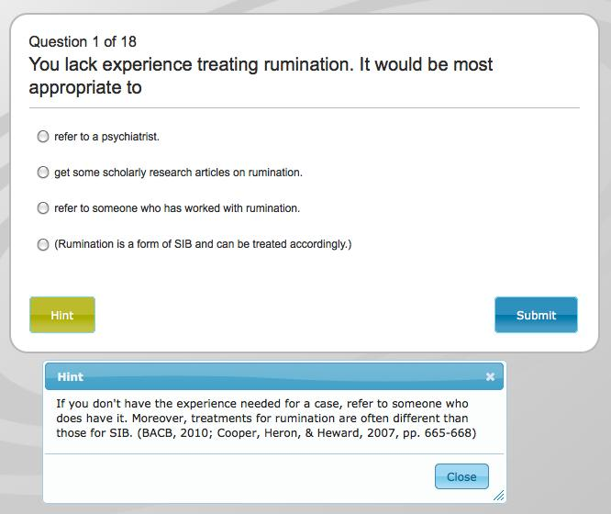

Slide 18
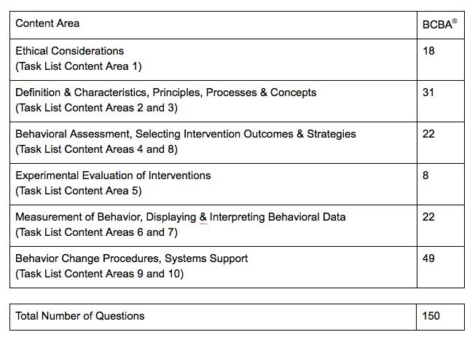

Slide 19
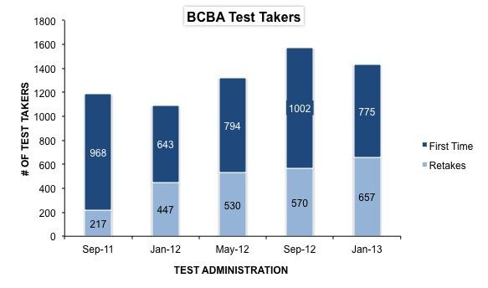
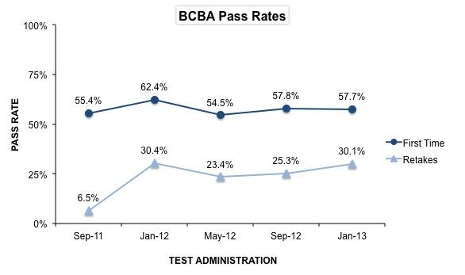

Slide 20
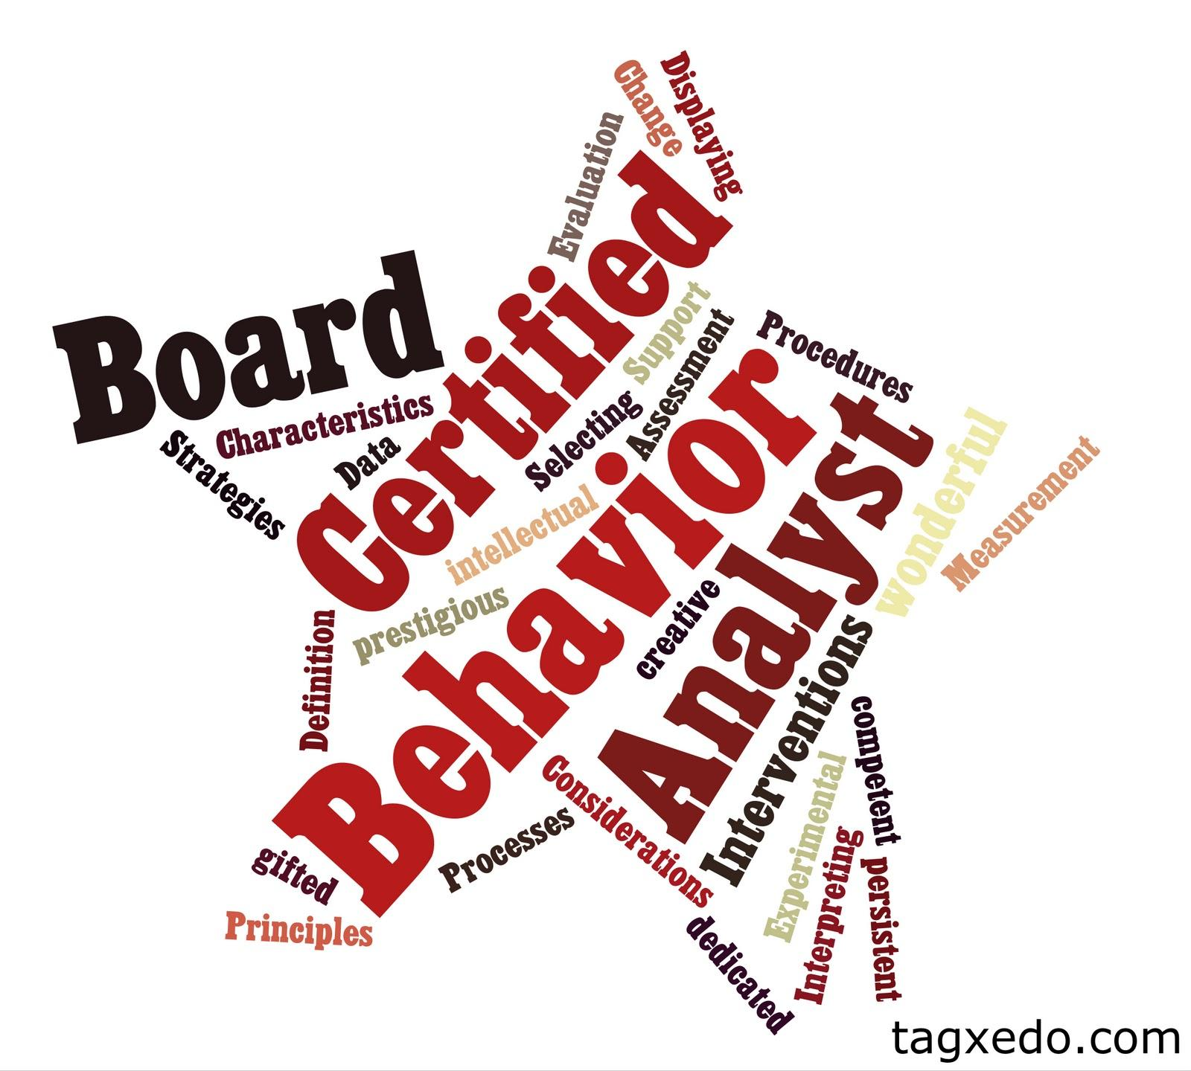
Rebecca Cornwell, MEd, BCBA!
...Coming in September 2013

