Slide 1
Into the looking Glass
A Glimpse of CCT and The Blind Date Cafe

Slide 2
Critical and Creative Thinking
Notes:
I came to Critical and Creative Thinking via my professional life in Human Resources. For those of you who may not know, Human Resources is not a fun loving field. It is filled with Federal and State law, rules, regulations, paperwork and often very raw emotion. People are vulnerable when dealing with professionals in Human Resources, to paraphrase Tennessee Williams, we end up relying on the kindness (honesty, trustworthness) of strangers.
My specialties are mediating and coaching; everything from onboarding orientation, conducting investigations, interpersonal issues, legal negotiations, and keeping employees from fighting on hot sweltering days in a Florida summer.
I was looking for a way to enhance my work; MBA – everyone had those, Law degree – I thought I would get bored. In my searching I happened on the CCT program and came to try it out and see if it had workplace applications.
I took my first class and was hooked.
I was looking for a way to enhance my work, and took a class to see if it was applicable. I was hooked.

Slide 3
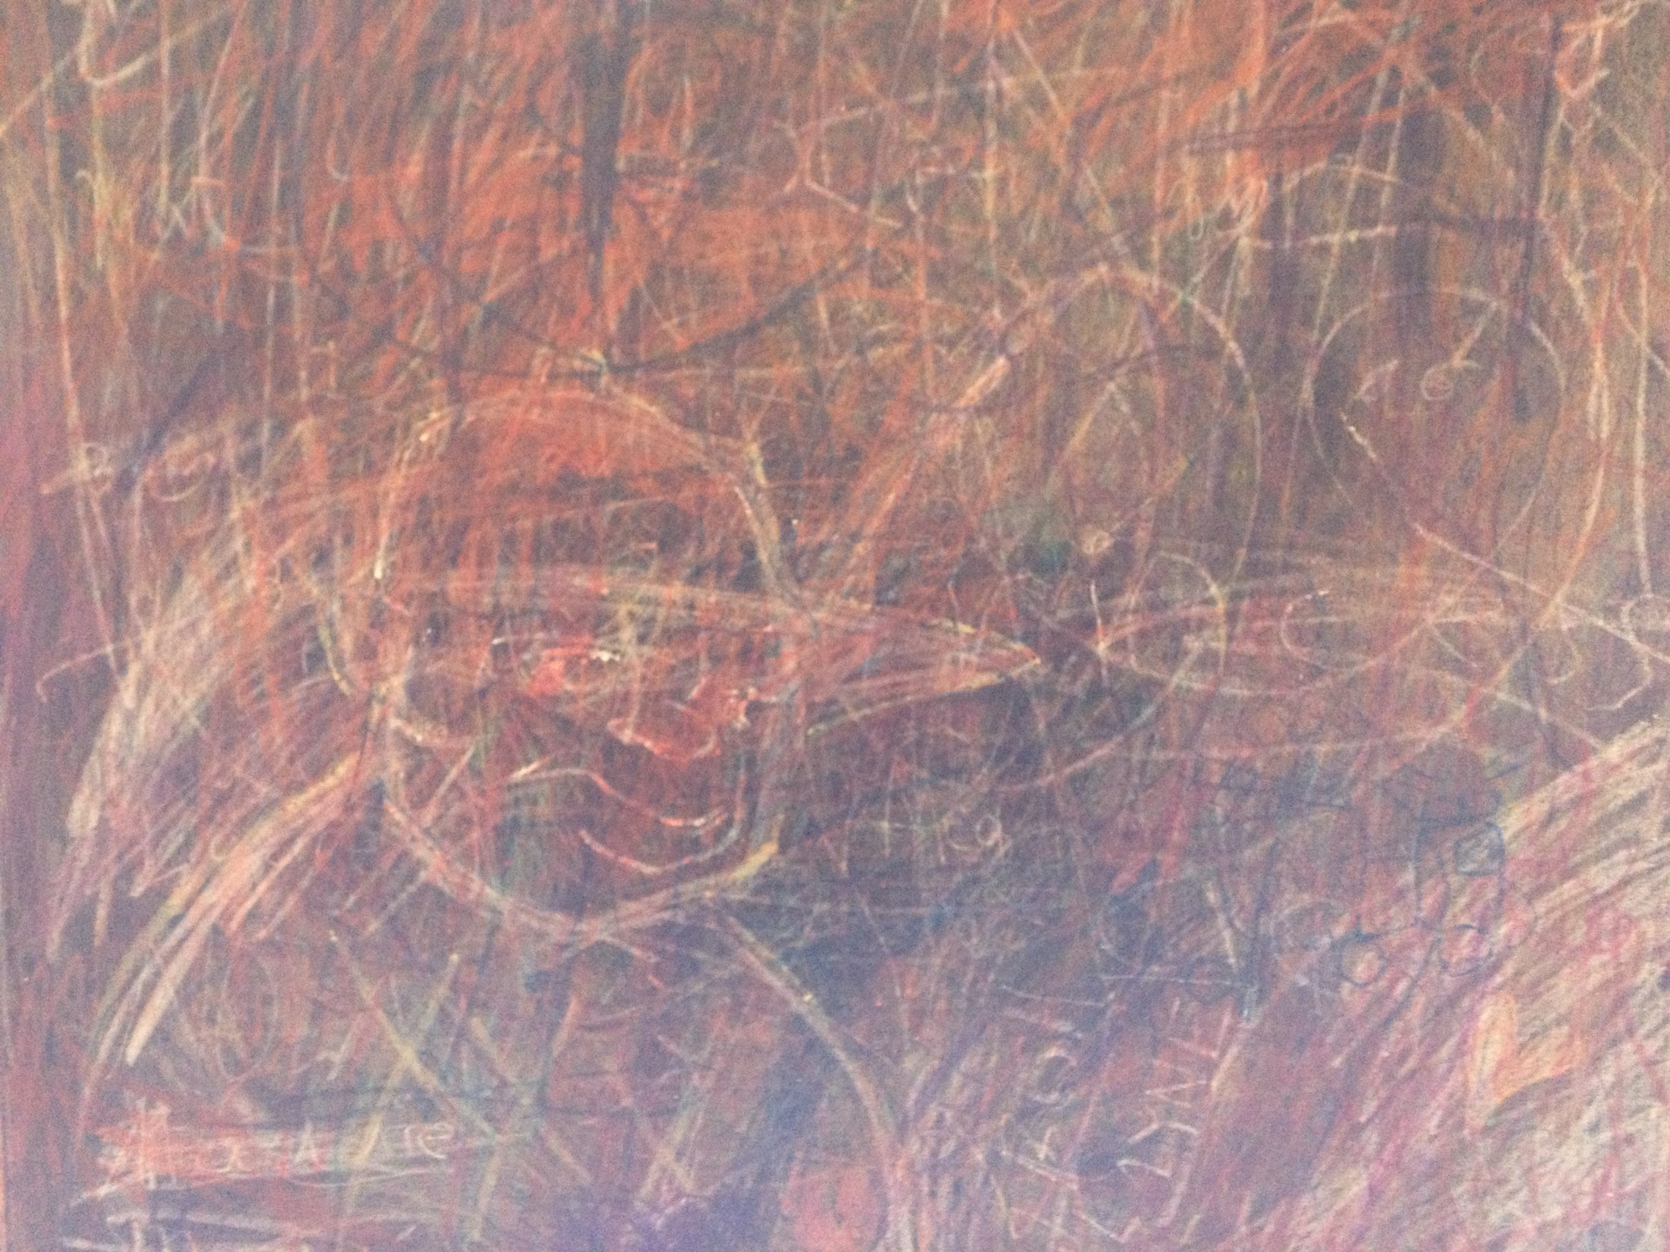
Group and individual strategies
Metacognition
communication
Concept development
Philosophical context
Workshops
Strategic thinking
reflection
Problem based learning
Identifying and disarming assumptions
Notes:
The skills, tools and techniques were invaluable in the business environment. I could see the difference in my work and I started to learn more about myself.

Slide 4
Evaluation clock
KAQF
Dialogue
Plus - Delta
Historical Scan
Research
Engagement with others
GOSP
Governing Question
Engagement
Focused conversation
Compelling Communication
Mapping
Freewriting
Daily Writing
Clarification through Communication
Notes:
I found that with everything I learned it was often easier for other to understand some of my new approaches if I gave a real life experience as an example. Basically, a story.
Stories are like a playground for the mind.
They provide the space where possibility can be examined, explored, and tested. I would imagine stories, scenearios, strategies, environments, contingencies, and events; and with some of these, the ones that intrigued me the most, I would write them down. This is true. I am a closet writer.

Slide 5
Confessions of a Closet Writer
Notes:
I have loved writing down my thought, ideas, and stories as long as I can remember. I have experimented with prose, poetry, non-fiction, fiction, instruction, fantasy, and plays.

Slide 6
Stories
Story
Notes:
Story is powerful.
Growing up I would look at myself in a mirror and tell stories, answer questions, and think through ideas. I would watch my eyes, I would only see them clearly if Iand wonder at the expressiveness of eyes.
Help us make sense out of chaos
Are useful teaching tools
Share messages and values
And
Can be a vehicle of questioning and dealing with ambiguity.

Slide 7
Notes:
I received my first pair of glasses when I was 9 years old. That is the first time I remember seeing individual blades of grass and leaves on trees, pebbles in the sidewalk, and a clear sky.
My world changed.
I have always considered my family a light hearted version of a Tennessee Williams play, or an extremely depressed Mark Twain.
We had records of Broadway musicals, portions of the classics on 50 Great Moments in Music, Daddy read to us from America’s Best Loved Poems, he worked on the cars, mowed the lawn, Mother cooked and lost our laundry. My family was filled with farmers, businessmen, and teachers. We were middle class and extremely concrete.

Slide 8
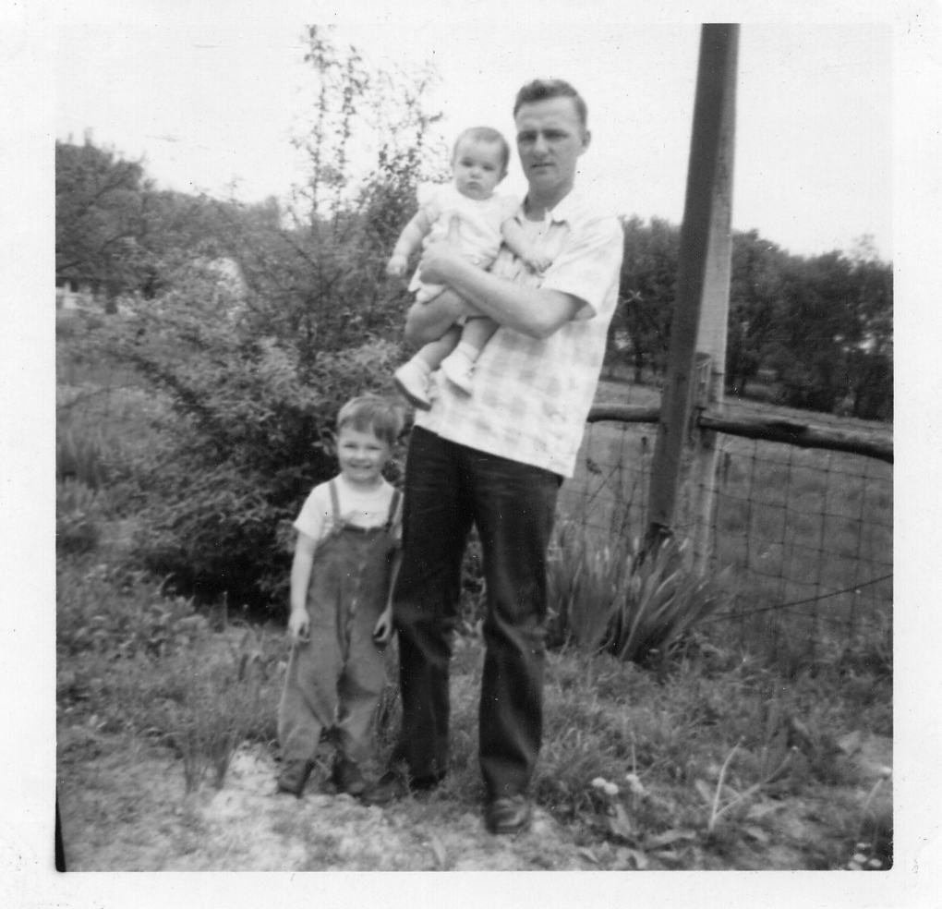
I come from a pretty concrete world…
Notes:
I come from a pretty concrete world.
My father loved to tell stories. He had a way with people and situations that could be filled with welcoming, humor and intelligence. Every evening at dinner he would start the conversation. It might have been about his day, the news, or something he read. His stories filled the room. When he was finished it was our turn. In these conversations I learned the subtle aspects of delivery, timing and surprise. Wit was valued and flawless presentation rewarded with hearty laughter, tears, and giggles. It was all about taking the everyday and making it engaging, entertaining, and memorable.
This was our life. The stories we heard and learned to tell reflected the world as we knew it.
There were stories and questions I had that were not welcome at the dinner table. It is amazing how we learn the boundaries of our families.
He had a way with people and situations that, in the best of times, was filled with welcoming, humor and intelligence. Every evening at dinner he would start the conversation by talking about his day. His stories had characters and events that filled the room with their presence. When he was finished we each had an opportunity to entertain and amuse. In these dinner conversations I learned the subtle aspects of delivery, timing, presence, and surprise.

Slide 9
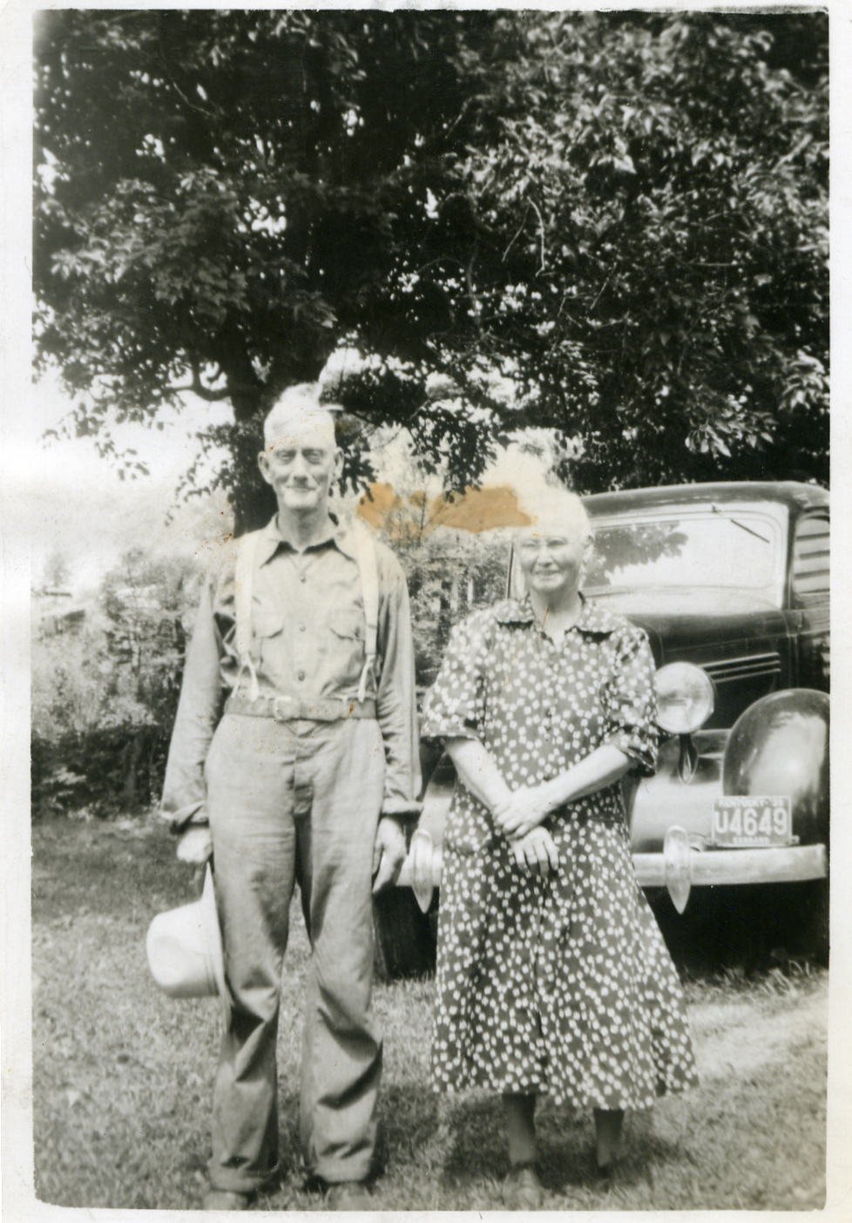
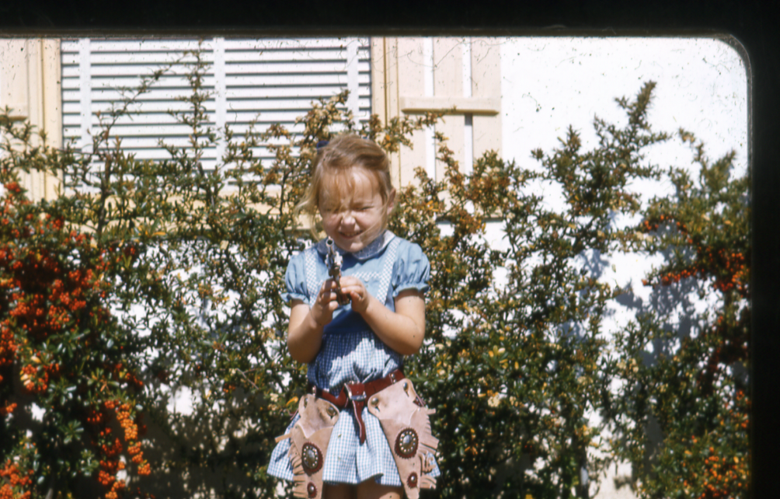
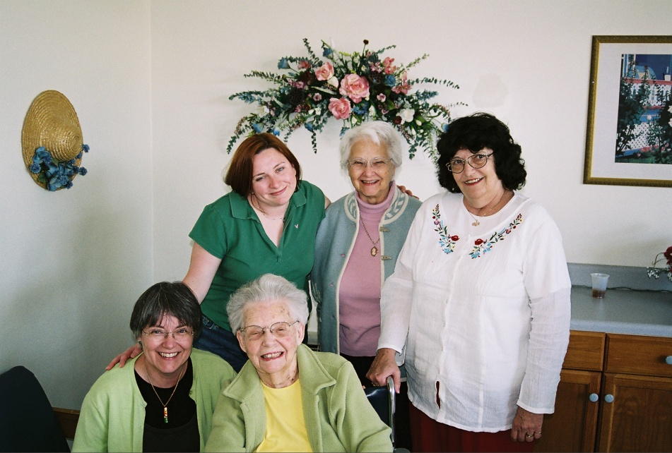
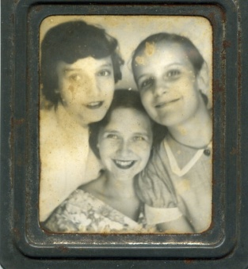
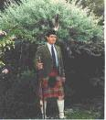
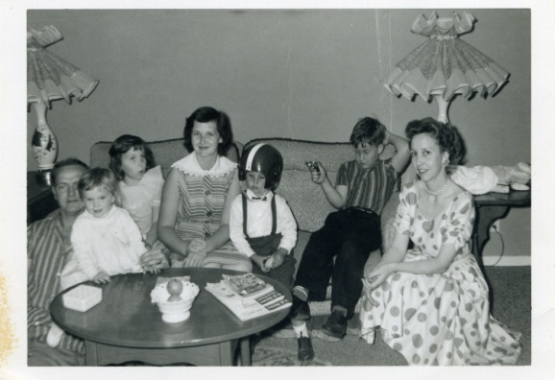
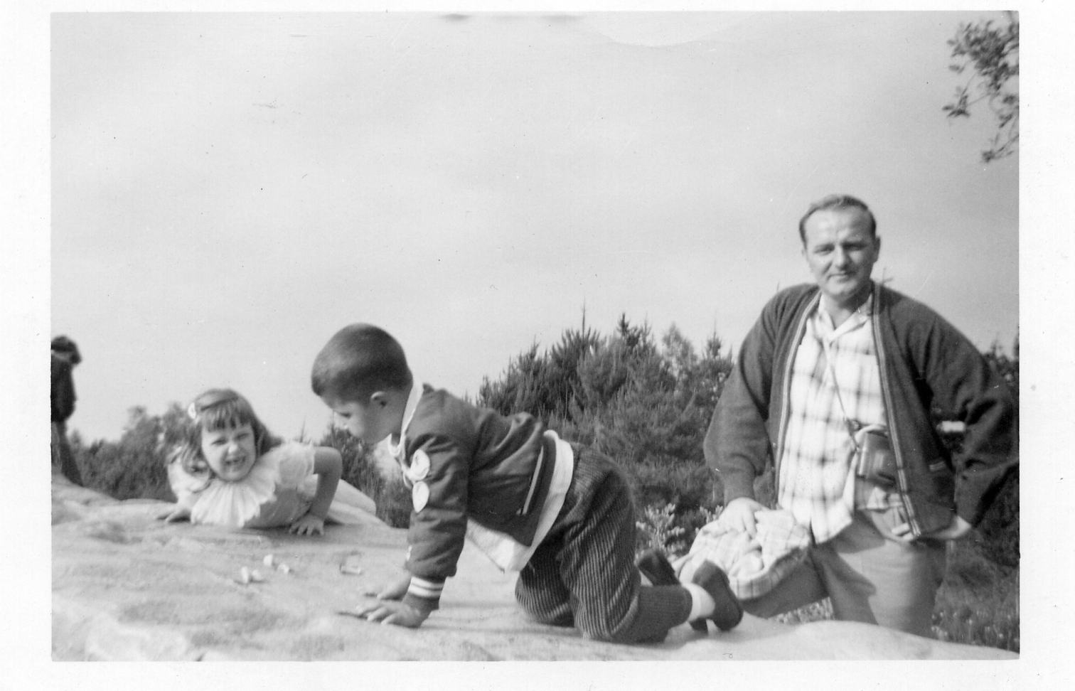
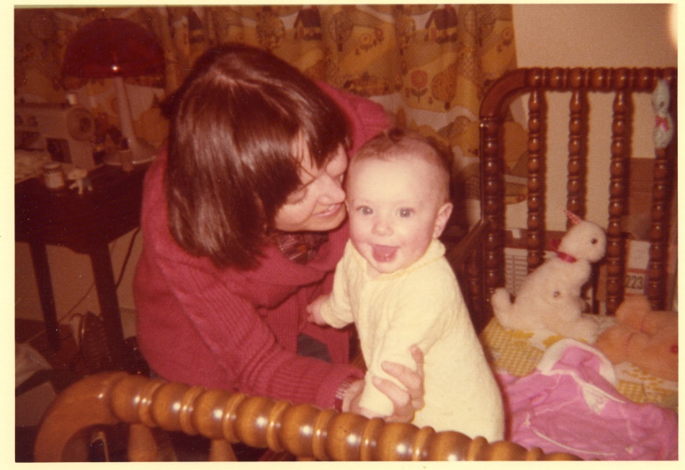
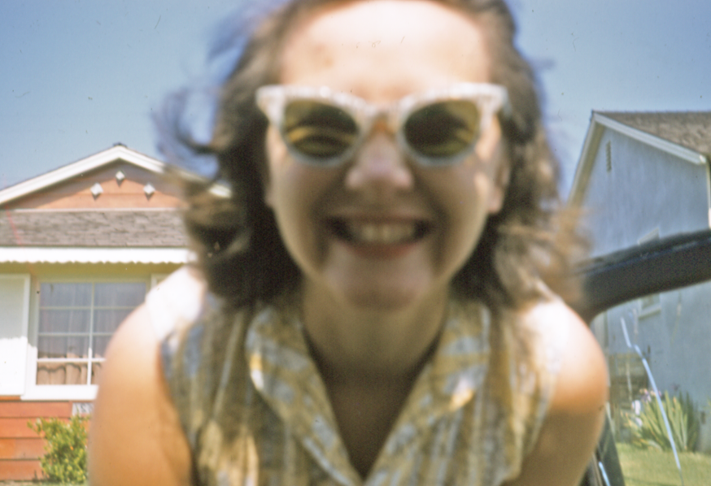
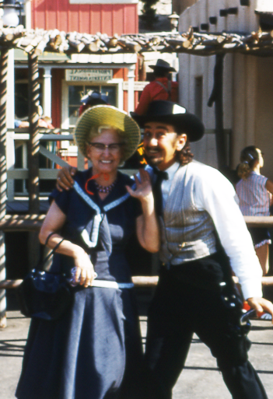
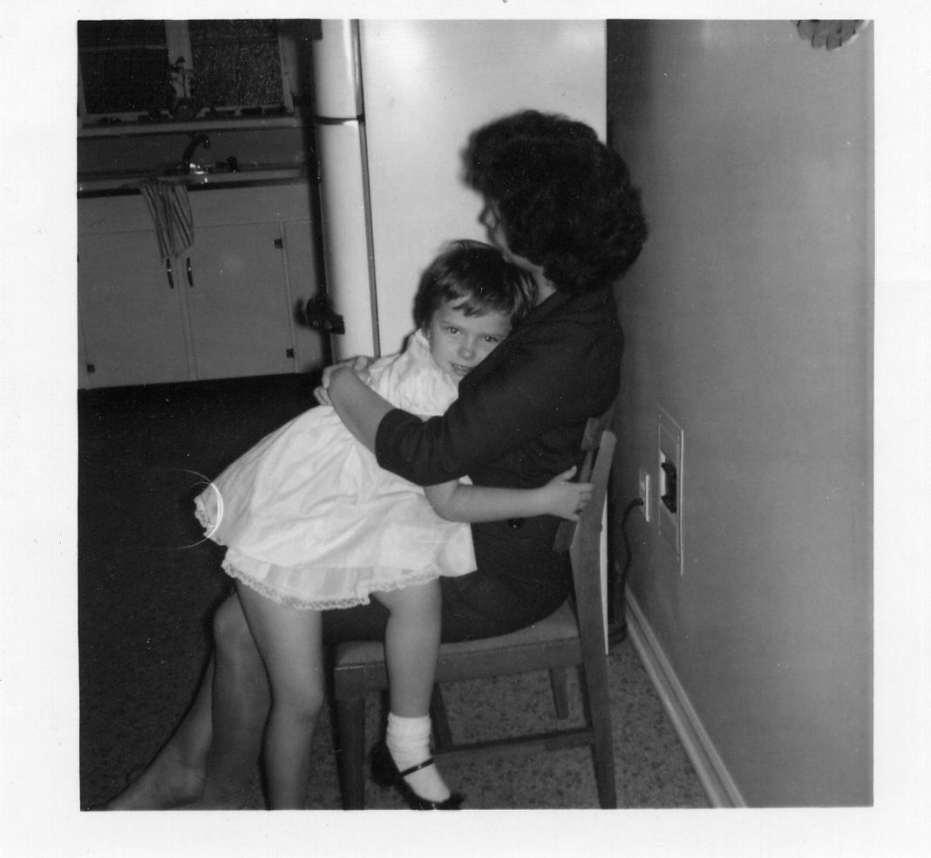
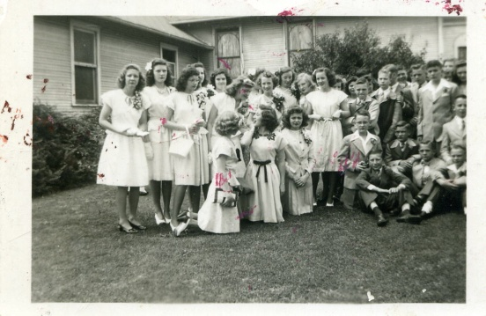
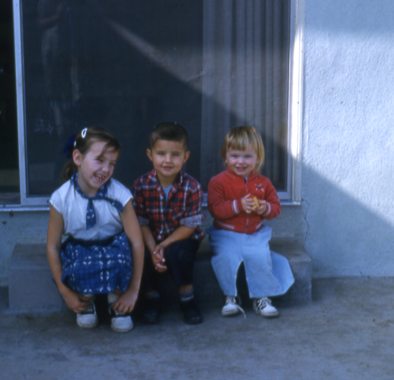
Notes:
We had all the usual suspects! heros and villians, bloodlines that went back to the American Revolution and some that did not, there were rivalries, and truces, loving and not so loving relationships. In my family I learned many things….
It was important to me to stay clear of the storm, when ever possible. And there were storms.

Slide 10
heros
Tennessee William’s Fan Club
Secerets
addictions
Alien Hunter
depression
Bad guy
Needs therapy
Notes:
I consider my family a light hearted version of a Tennessee Williams play, or an extremely depressed Mark Twain.
We had records of Broadway musicals, portions of the classics on 50 Great Moments in Music, Daddy read to us from America’s Best Loved Peoms, he worked on cars, mowed the lawn, Mother cooked and lost our laundry.
This was a family filled with farmers, businessmen, and teachers.
There was a distrust of intellectuals, ideas and actions were either right or wrong, and everyone was expected to be independent, strong, and uncomplicated.
In the uncomplicated category we failed miserably. Thank goodness. From an early age I was aware that what appeared clear and simple at first glance could be filled with complications and contradictions, fear and loathing.
An important lesson was not to question.
When there was turbulence it was important to stay clear of the storm, and there were storms.

Slide 11
Stories
Story
Notes:
I began to wonder, what the influences of CCT might have on my writing.

Slide 12
Play | Premise | Focus
Mothers in Love | Stage mothers at a children’s beauty pageant. | Tense competition
Brother Abel’s Judgment | Character in a room he can’t exit, changing situations | Confusion and lack of personal insight
Laundromat | Relationships formed by proximity | Citizens of a Laundromat and how they build community
Blind Date Café | “No one expects the Spanish Inquisition” | Good humored look at people and relationship seeking.

Slide 13
Process: Creating the Vision
Personal interest in a story or situation,
Envision characters
Envision setting/location/scene

Slide 14
Character Development
Select characters
Write
Notes:
I usually begin with an idea of a character. I envision them in the setting and wait. See their action, and hear what they are saying. This is very interesting.
There are time when what I would like the character to say just doesn’t work. And I’m back to waiting, waiting for the right voice to direct my writing.
In fact this is a difficult process that takes discipline.

Slide 15
Process
Select characters
Write
Vision
Script
Personal interest in story
Select setting
Self-edit
Notes:
A process.
Talk about the character building and the setting.

Slide 16
Process
Peer Review
Select characters
Write
Vision
Script
Personal interest in story
Select setting
Self-edit
Notes:
A process.
Talk about the character building and the setting.

Slide 17
Stories
The Blind Date Cafe
Notes:
The Blind Date Café
Inspired by actual events, this play does not actually represent individuals, just some of the fascinating ambiguities and gross biases, and , not that anyone is surprised, complete lack of reflection and self awareness possessed by some to amuse me.
Being amused, I waned to share, what better way to share than to write a play!
Unfortunately, a play is a little more tedious to write than it is to imagine. There is actually ……

Slide 18
Questions?

Slide 19
Idea!
Notes:
There are times when an idea may introduce a new character or dimension to the play.
In the depths of my on-line dating experience, I began to wonder what Critical and Creative Thinking tools might be beneficial. One of the first thoughts that came to mind was……SWOT! Of course!

Slide 20
SWOT Analysis for Dating!

Slide 21
SWOT Analysis for dating
Strengths | Weaknesses
Opportunities | Threats
Intelligent
Patient
Egotistical
Self-centered
Financially stable
Talks about ex-relationships
All the time
Really, all the time!
Notes:
What thinking person hasn’t wished they had better tools when looking for that perfect match.

Slide 23
I come from a pretty concrete world…..
Not a serial killer
Would watch the fire on
Cake without telling adults
Would catch fire in 10 min
Notes:
My father loved to tell stories. He had a way with people and situations that, in the best of times, was filled with welcoming, humor and intelligence. Every evening at dinner he would start the conversation by talking about his day. He filled his stories with characters and events that filled the room with their presence. When he was finished the we each had an opportunity to entertain and amuse. In these dinner conversations I learned the subtle aspects of delivery, timing, and surprise. Wit was falued and flawless presentation rewarded with hearty laughter, tears, and giggles.
Everyday provided a new opportunity to create stories. And when that failed to inspire there was always….

