Slide 1
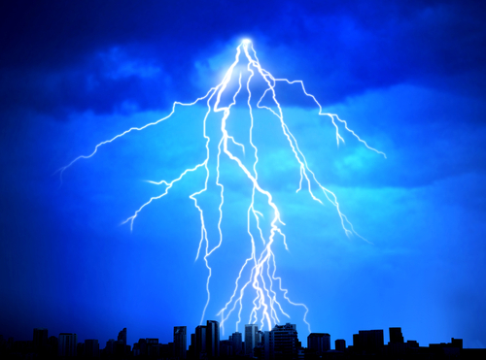
Pentimento:
A Process of Creativity and
Understanding the Layers
גלגול הנשמות

Slide 2
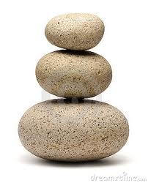
Introduction:
What is creativity?
Short Stories:
Heaven and Earth
Reflection:
The After-thought

Slide 3
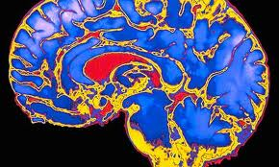
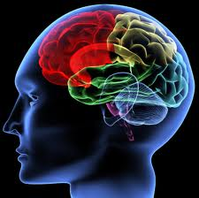
Dreams, Dreaming and The Subconscious
The brain is the “most extraordinary and complex creation in the universe.
Home to your mind and personality, your brain houses your cherished memories and future hopes.
It orchestrates the symphony of consciousness that gives you purpose and passion, motion and emotion.”
Notes:
http://www.quantumconsciousness.org/presentations/whatisconsciousness.html

Slide 4
Bumping Into My Blind Spot
Writing curriculum
to integrate science
and humanities

Slide 5
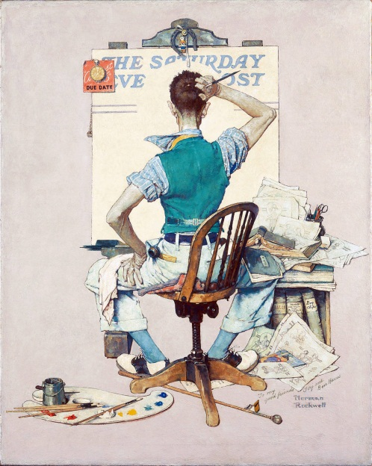
Scharmer writes that creative work can be seen in three ways:
1. We can look at the finished painting.
2. We can observe the process.
3. We can observe the artist standing in front of the empty canvas.

Slide 6
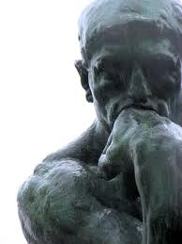
The Cognitive Process of Change:
EVALUATE:
Why I want to make the changes?
Why I feel I need to make those changes?
Are there facts or ideas to support it?
Consider if I’m working around a blind spot?

Slide 7
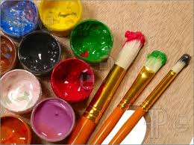
Scharmer asks:
What happens in front of the
completely white canvas?
What prompts the artist to
make that first stroke?

Slide 8
How do I write a story? Is it memory? Is it art? Is it influenced by a book I read or the author ? What of Kant’s definition of genius- Is it original?
I thought about the process:

Slide 9
גלגול הנשמות
Life is a Journey

Slide 10
Are We Tabula Rasa ?
Are we a blank canvas
waiting to be painted ?

Slide 11
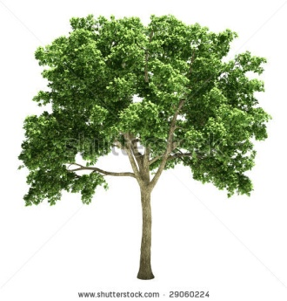
Are We Acorns?

Slide 12
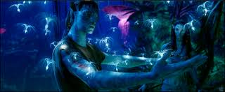
Are we clever robots?
Are we avatars?

Slide 13
Are we pentimento?
If we’re avatars, then we must be pentimento.
If we’re pentimento-
how many layers deep are we?

Slide 14
What is creativity?

Slide 15
Kant: Critiques of Pure reason
Kant believed that intelligence has three parts:
understanding
judgment
reason
He also separates creative and imitative intelligence and refers to them as genius and spirit of imitation.
Genius is a talent for producing that for which no definite rule can be given, and not an aptitude in the way of cleverness for what can be learned… originality must be its primary property. …Everyone is agreed on the point of the complete opposition between genius and the spirit of imitation. Now, since learning is nothing but imitation,..”

Slide 16
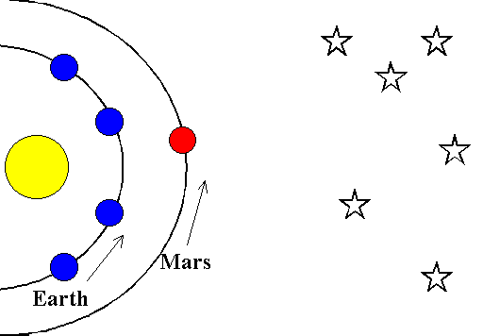
A Copernican revolution?
Kant: “knowledge is not something we passively receive from the world, instead the mind picks what it receives…”
Definition as a metaphor:
Knowledge is not at rest; in fact it’s continually being challenged.
A change in perspective that can be a paradigm shift
Common sense may not have the answers.

Slide 17
Questions:
Q: What is Divine?
Q: What is Heaven and what is death?
Q: How is my mind connected to the Divine?
Q: Do Divine beings watch over me and read what I write? How do we share minds and memories when I write, or is it just a channel?
Q: Do I have free will?

